Slide 1
My 37 38-Year Journey with Neural Networks:
Can They Further Unlock Pichia's Potential?
Steven M. Muskal
Chief Executive Officer
Eidogen-Sertanty, Inc.
smuskal@eidogen-sertanty.com
steven.muskal@gmail.com
3/26/2024

Slide 2
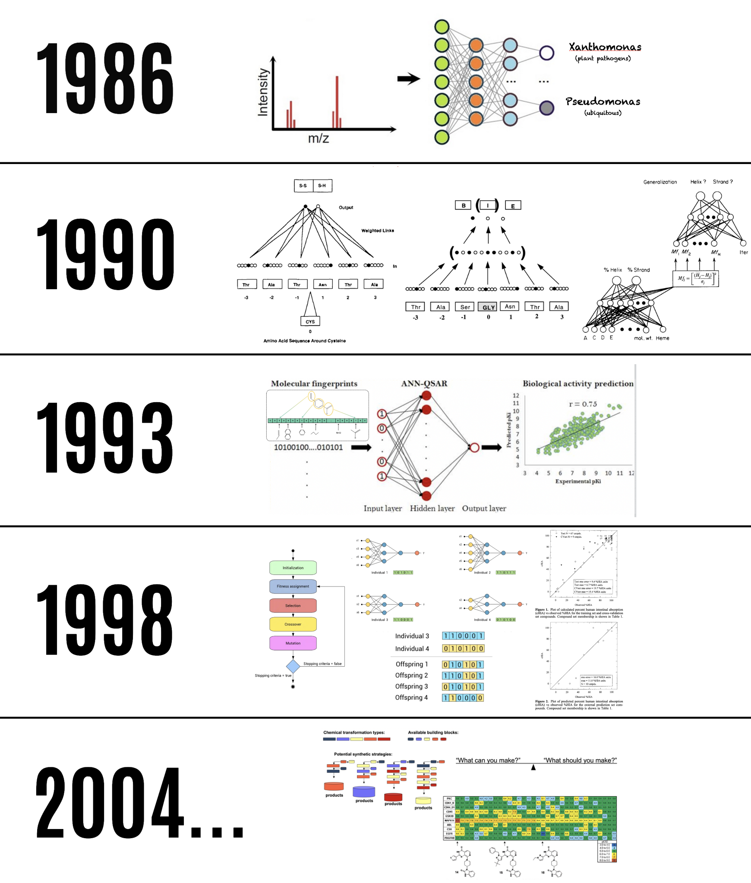
My Journey Began in the Late 80’s
Mines
Berkeley
MDL
Affymax
Eidogen

Slide 3
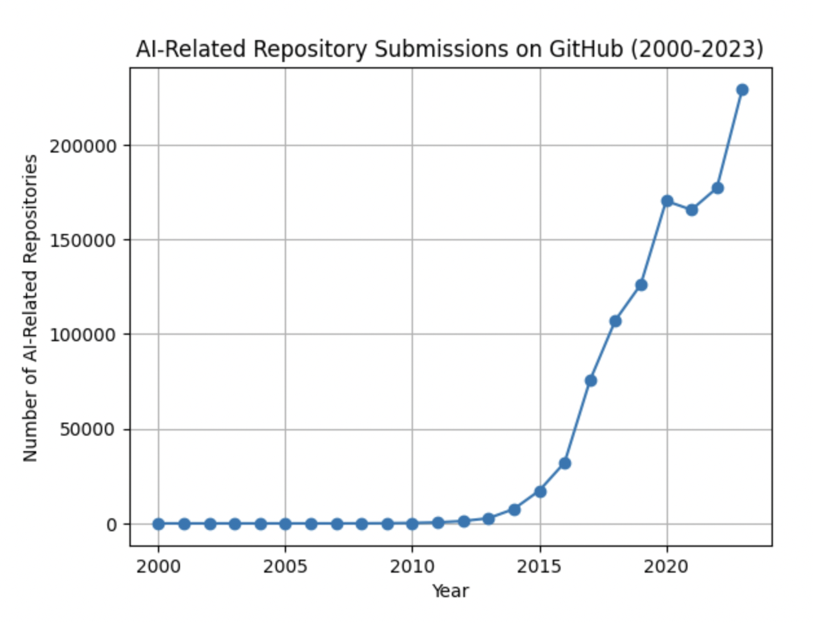
Open Source Has Changed the World

Slide 4
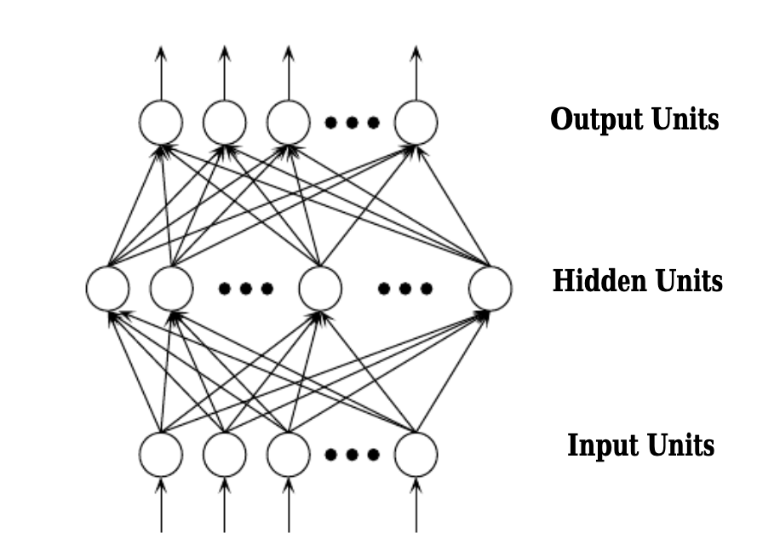
Neural Network Basics:
How They Learn and Predict
Output Patterns
Input Patterns

Slide 5
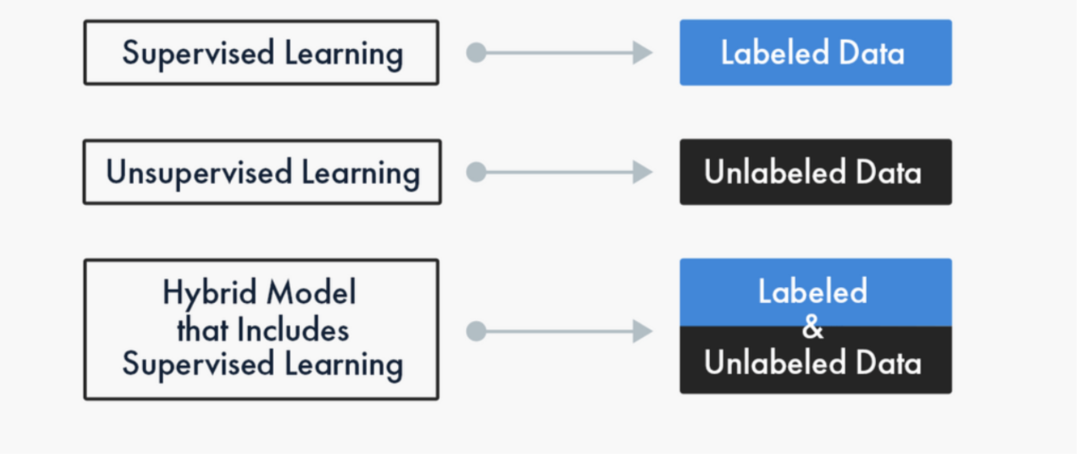
Supervised vs Unsupervised Training

Slide 6
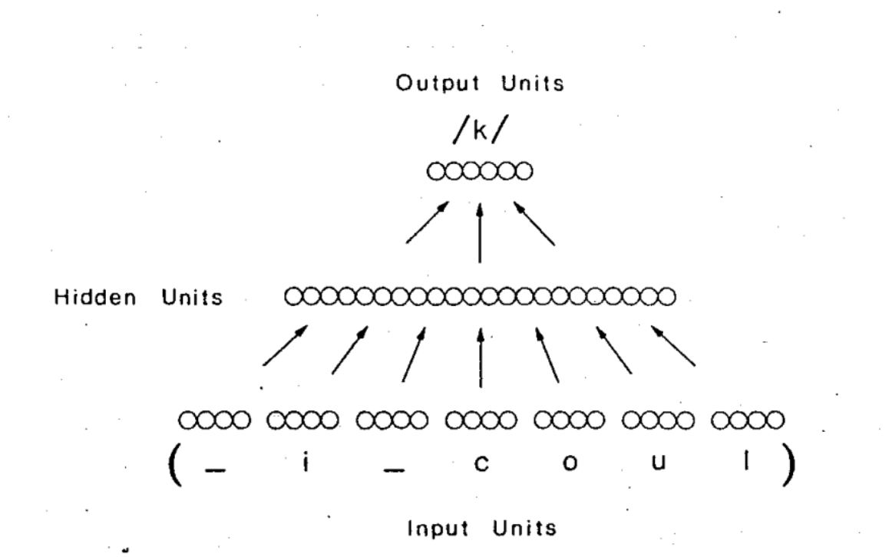
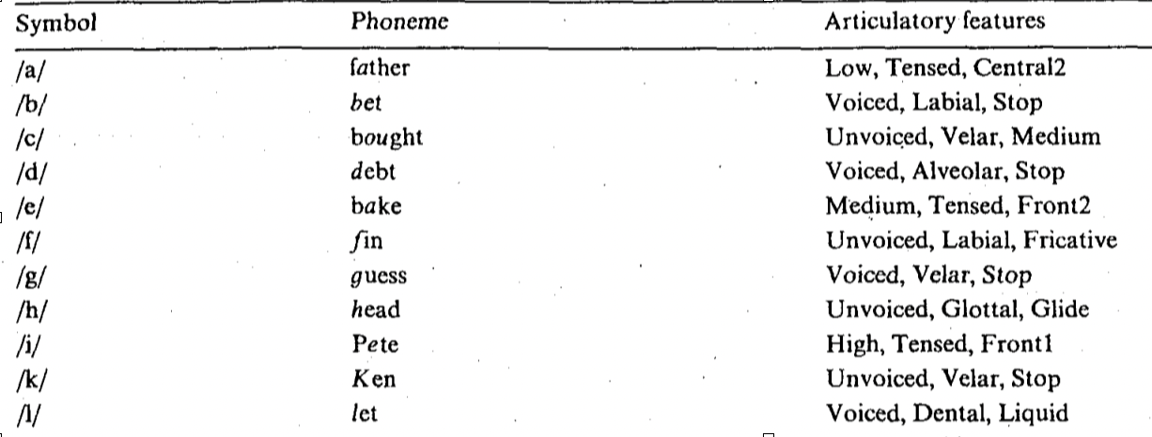
An “Inspirational” Neural Network

Slide 7
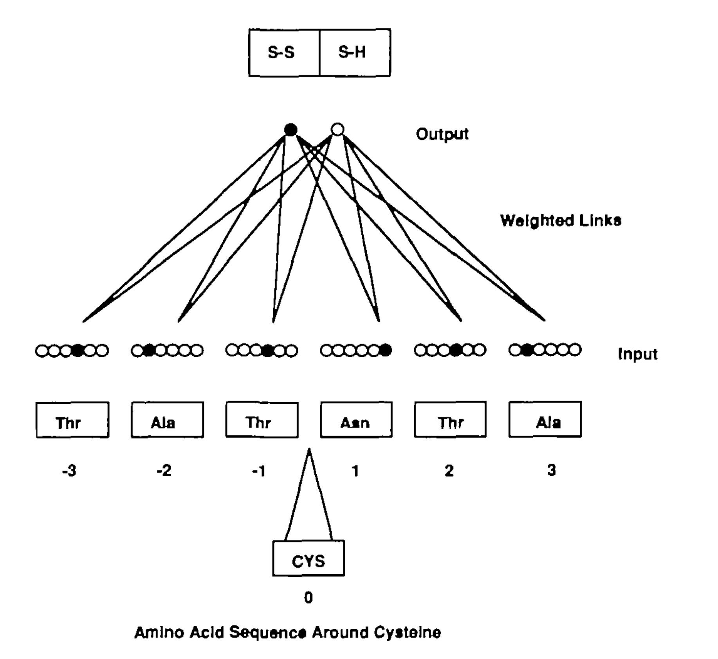
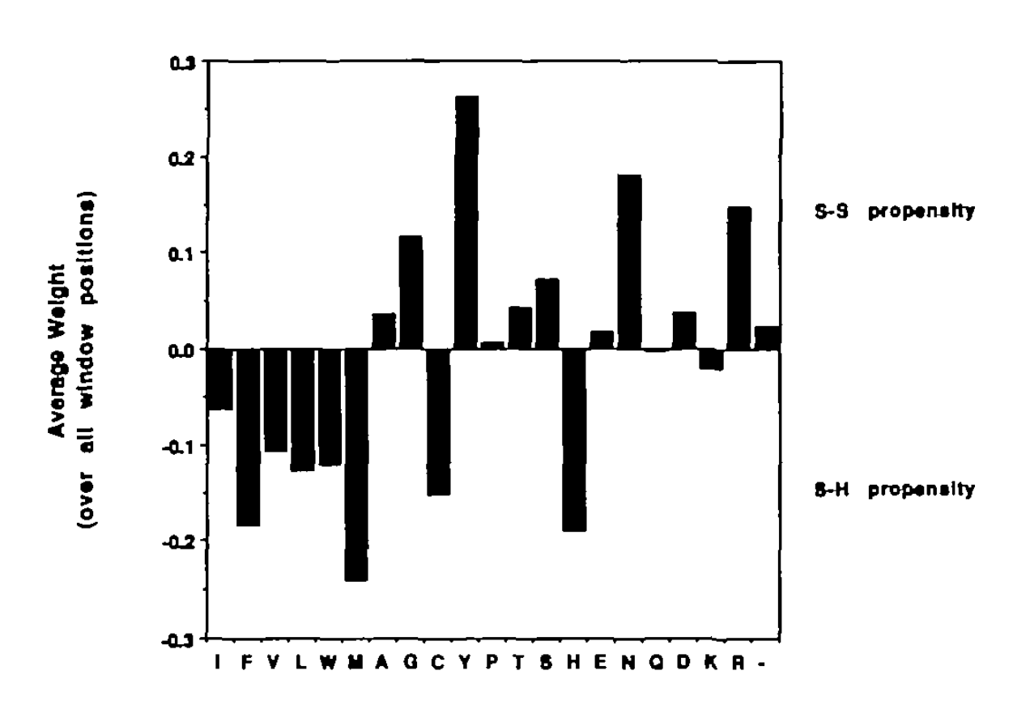
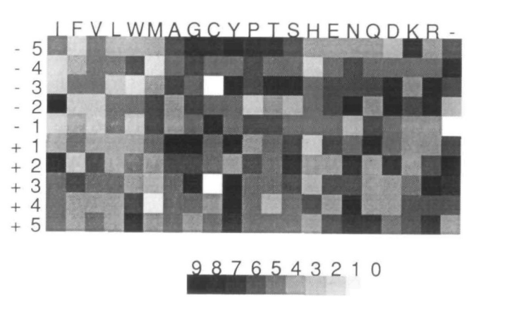
Predicting Cysteine’s Disulfide-Bonding State
(1990)
https://pubmed.ncbi.nlm.nih.gov/2217140/

Slide 8
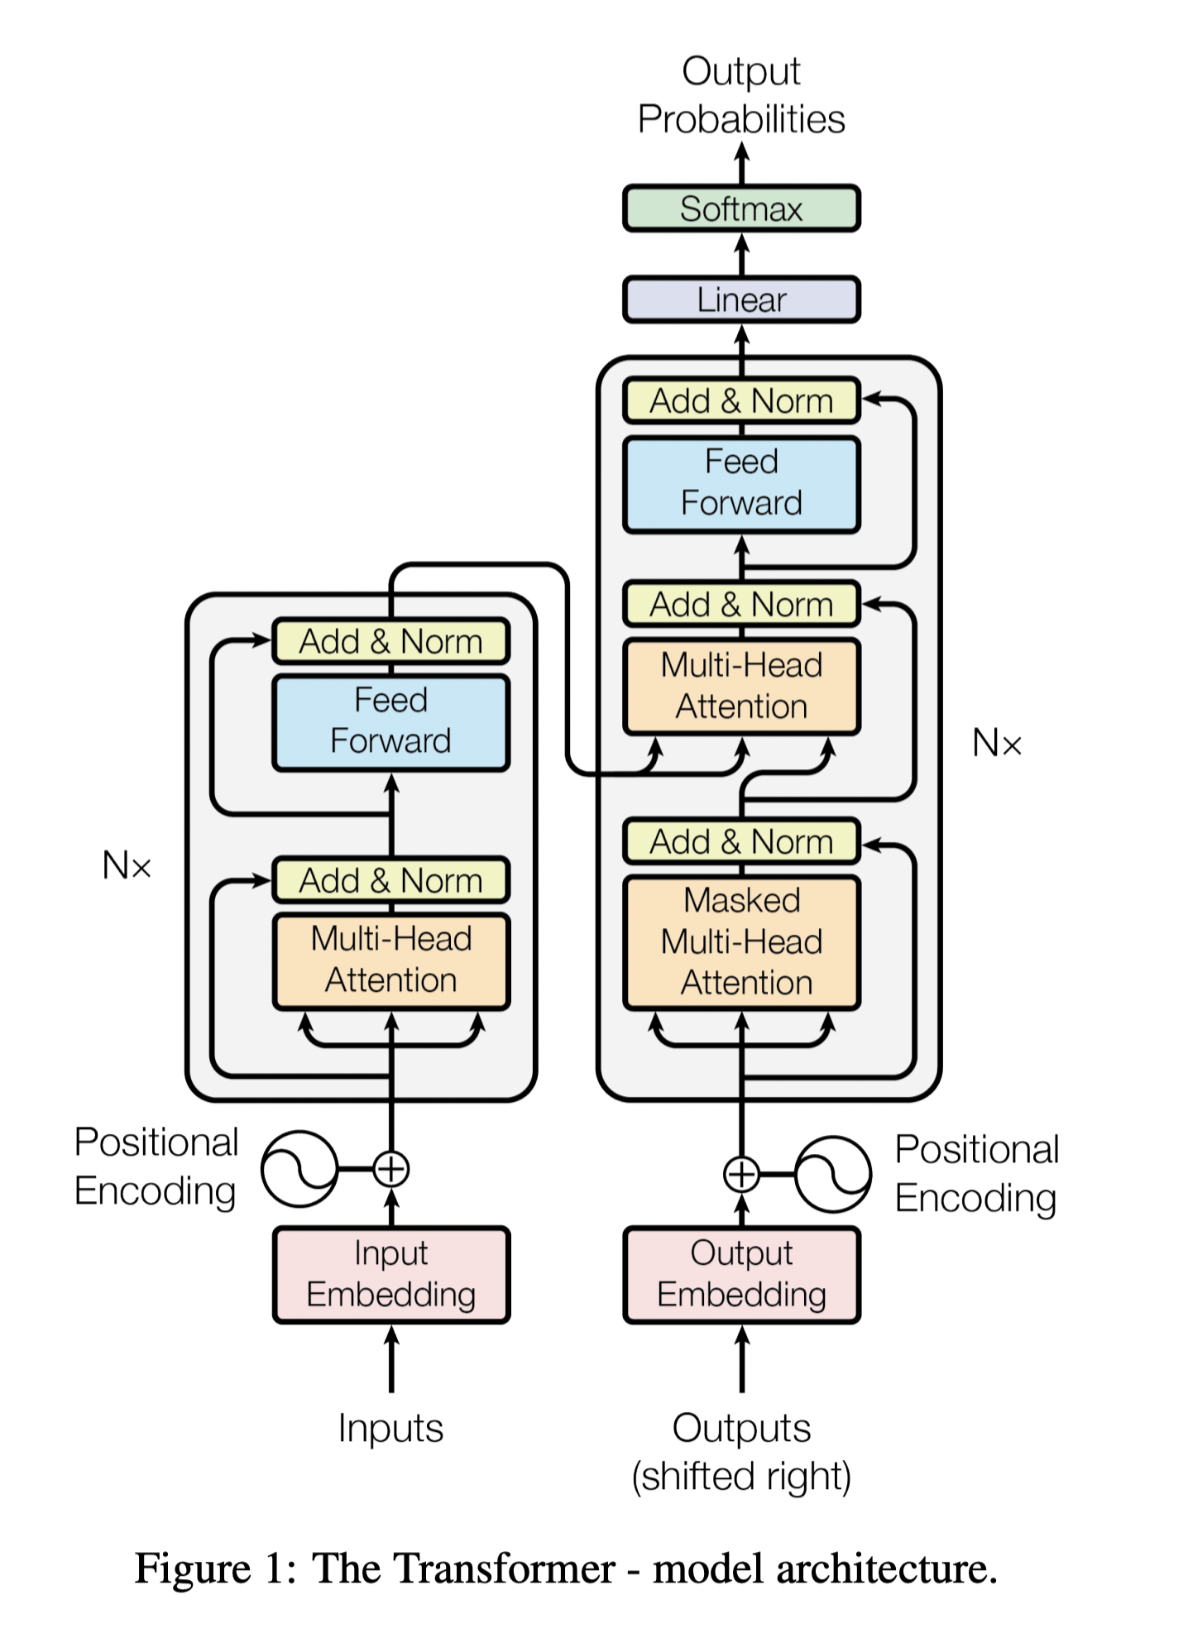
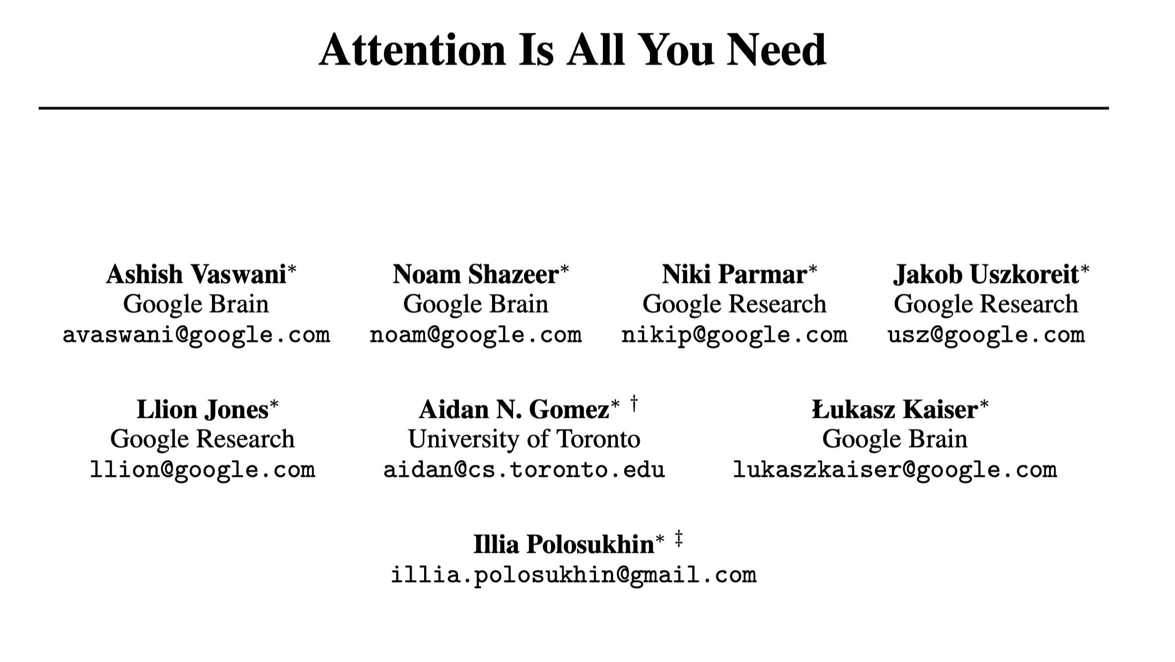
“Attention Is All You Need”
(2017-present)
Jun2017 - https://arxiv.org/pdf/1706.03762.pdf
(last revised Aug2023)

Slide 9
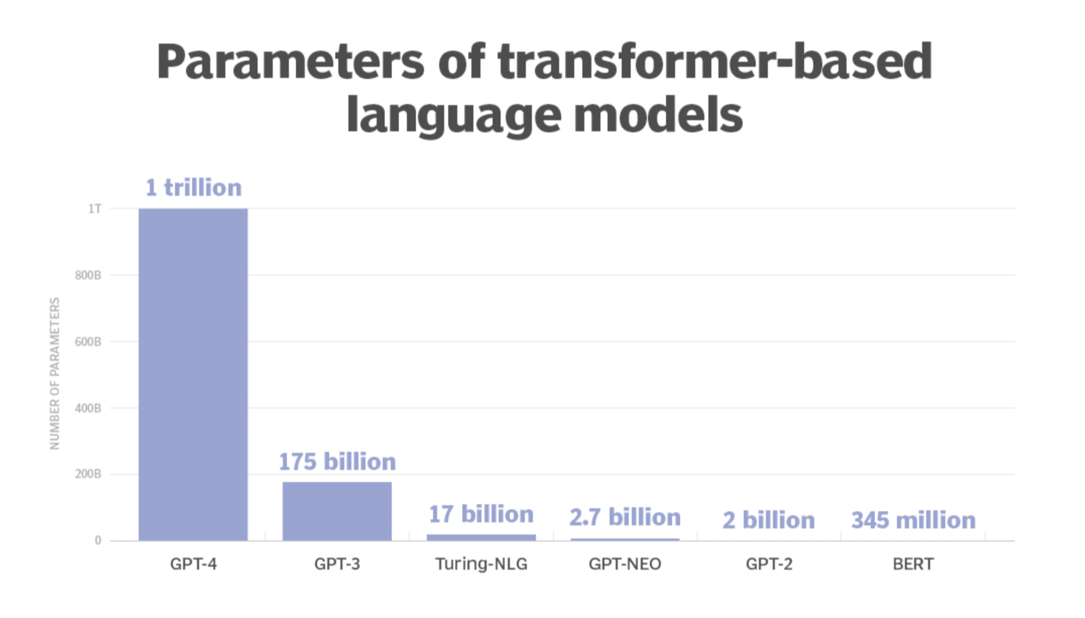
https://www.techtarget.com/whatis/definition/large-language-model-LLM

Slide 10
Applicable Areas wrt Pichia
Strain Engineering & Expression
Optimal Expression Conditions
Scalability
Methanol Utilization Control
Post-Translational Modifications
Product Recovery and Purification
Contamination Control
Regulatory Compliance
Cost-Effectiveness
Advances in Bioreactor Design and Process Monitoring

Slide 11
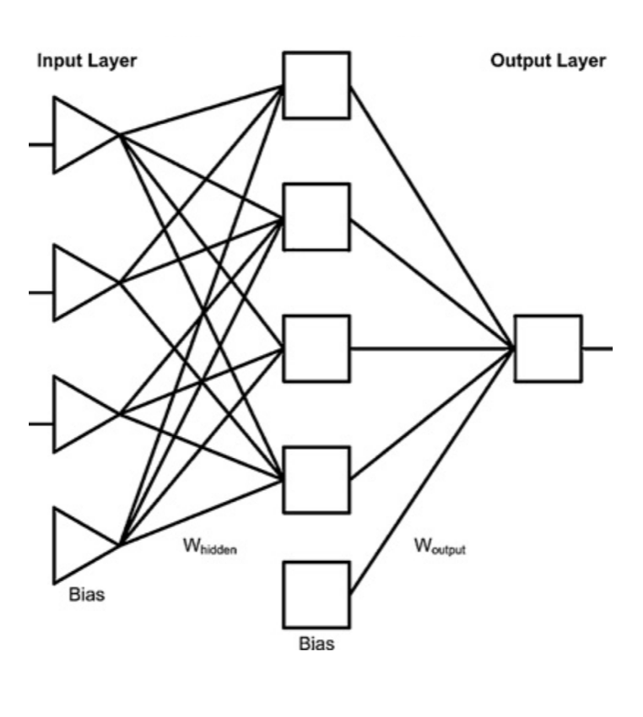
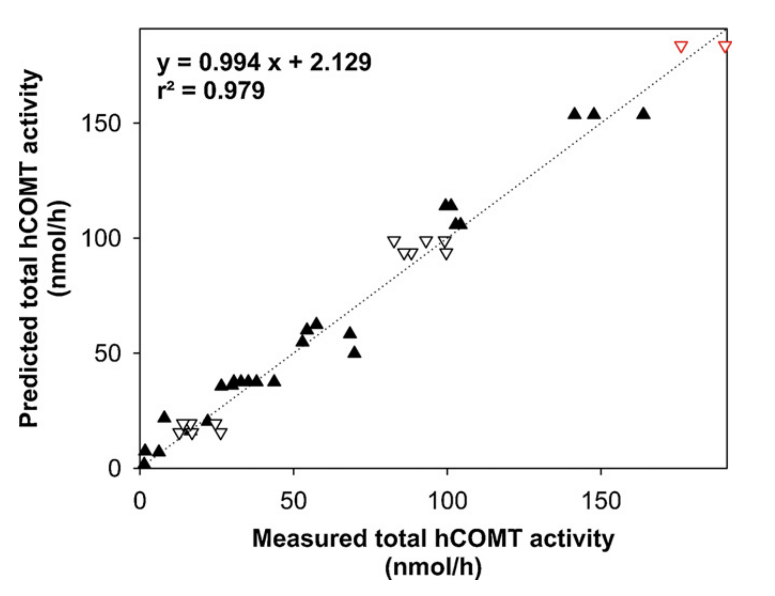
Optimization of Fermentation Conditions
Human Soluble Catechol-O-methyltransferase (E. coli)
(2012)
Temp
pH
hCOMT
RPM
Calibration
Validation
Last Optimization Step(s)
https://pubmed.ncbi.nlm.nih.gov/22498435/

Slide 12
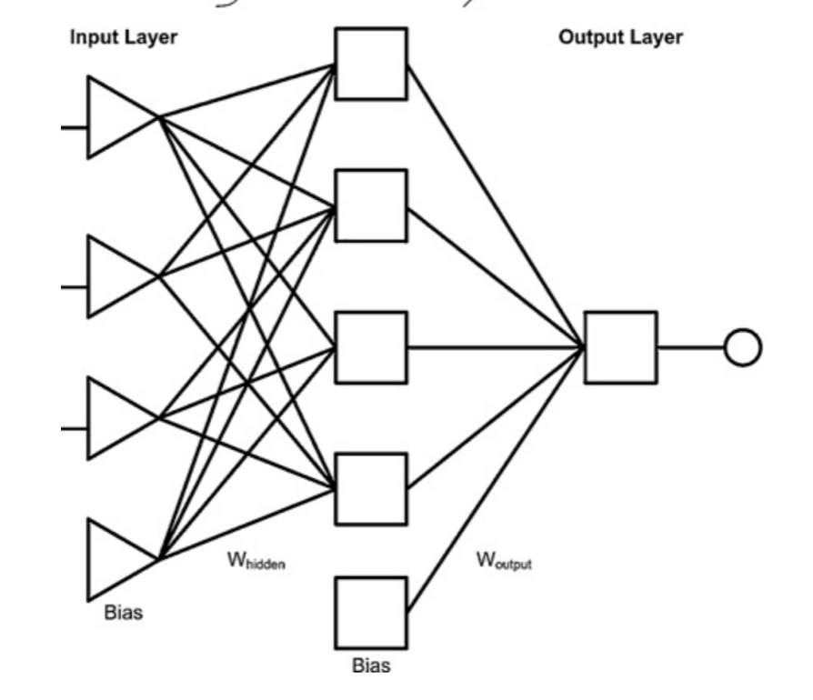
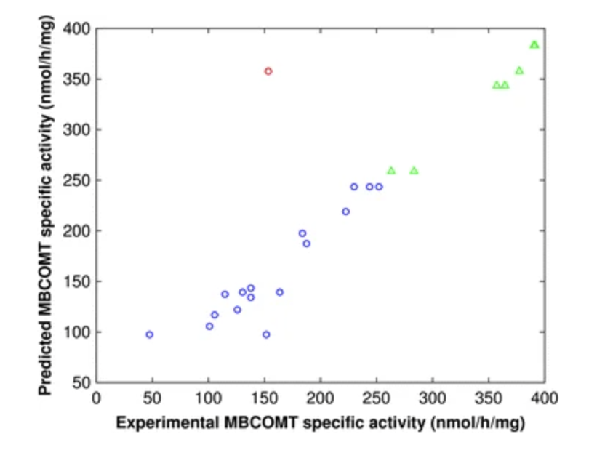
An Artificial Neural Network for Membrane-Bound Catechol-O-Methyltransferase Biosynthesis with Pichia Pastoris Methanol-Induced Cultures
(2015)
Temp
DMSO
MBCOMT
MeOH
Central Composite Design
Model Optimization
Outlier(s)
https://www.ncbi.nlm.nih.gov/pmc/articles/PMC4527236/

Slide 13
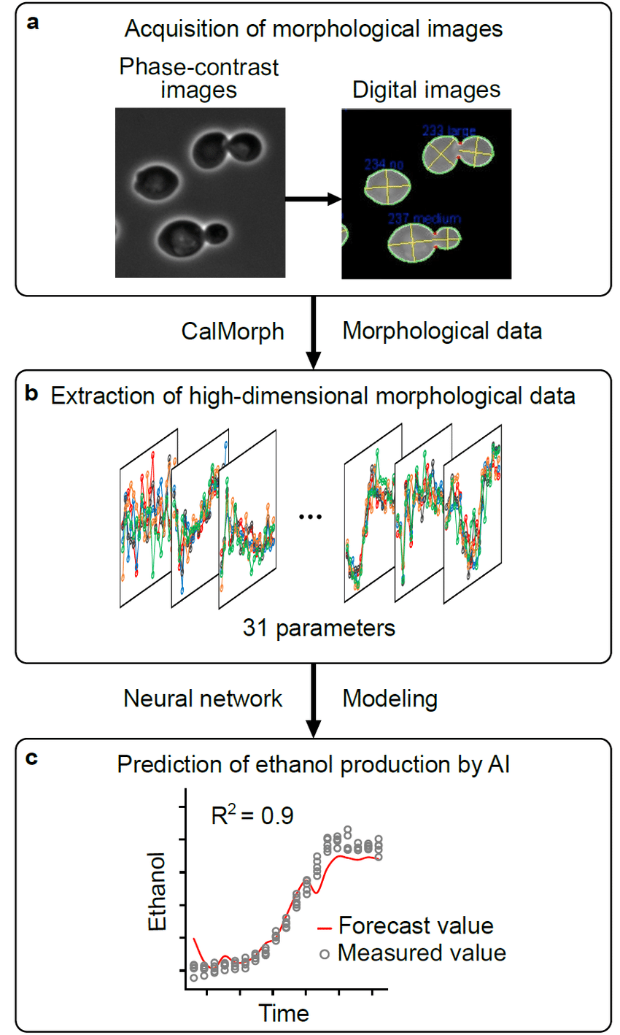
AI-based Forecasting of Ethanol Fermentation Using Yeast Morphological Data
(2021)
https://academic.oup.com/bbb/article/86/1/125/6424286

Slide 14
What Challenges Are You Facing?
Output Patterns
Input Patterns

Slide 15
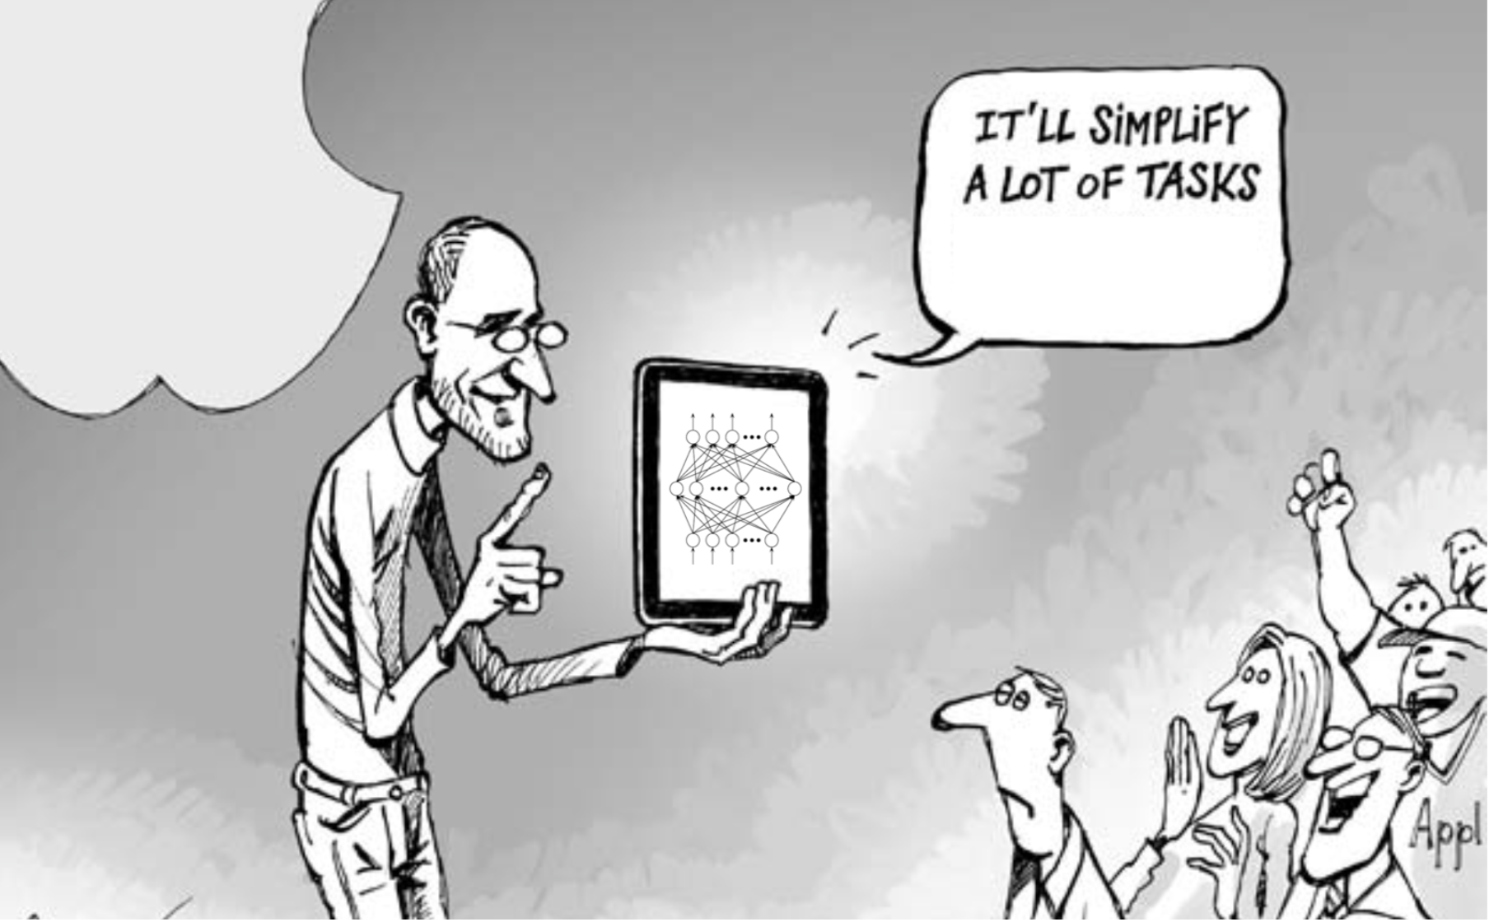
You Do All
The Time
smuskal@eidogen-sertanty.com
steven.muskal@gmail.com

Slide 16
Looking Beyond Your Sphere of Understanding
My first business card
Coke and Drugs
Trudging through sand-hill
Acquiring a company I helped build
Developing a new brand
Supplemental Slides

Slide 17
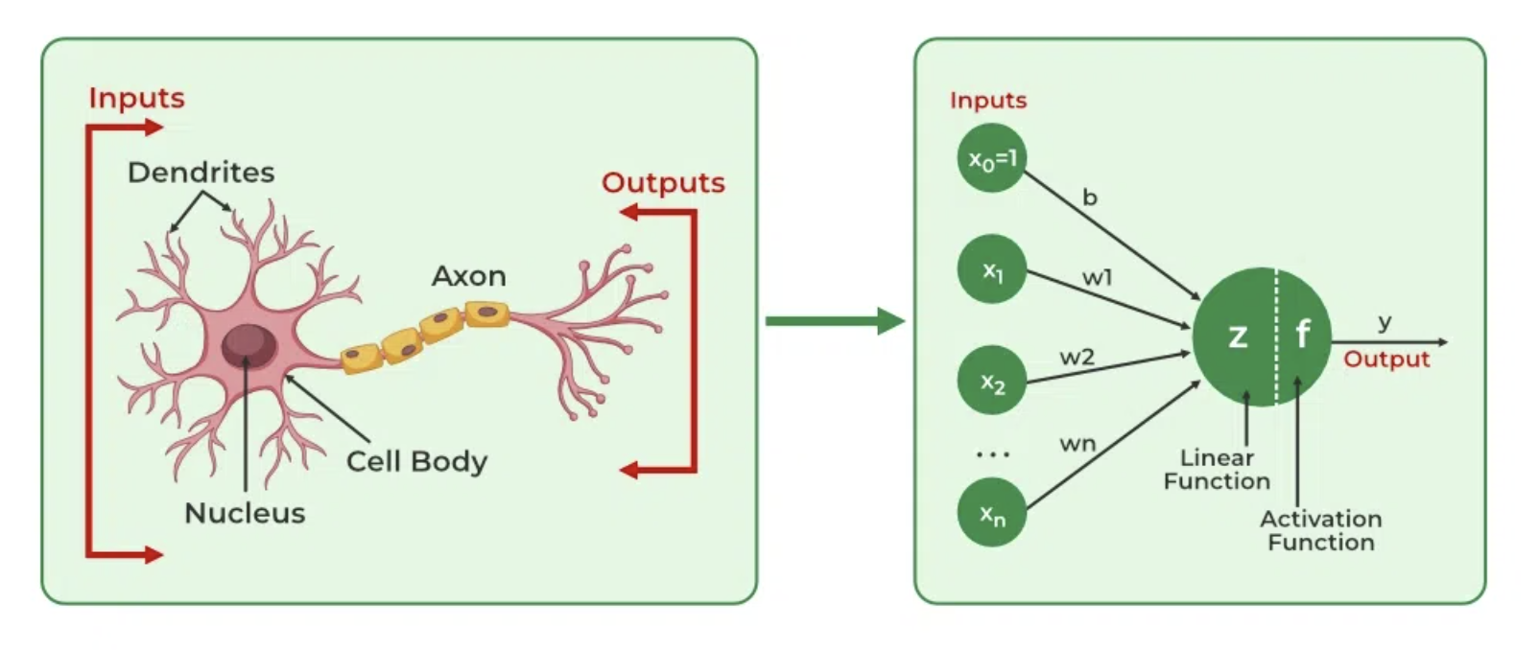
The Ultimate Decision Maker…

Slide 18
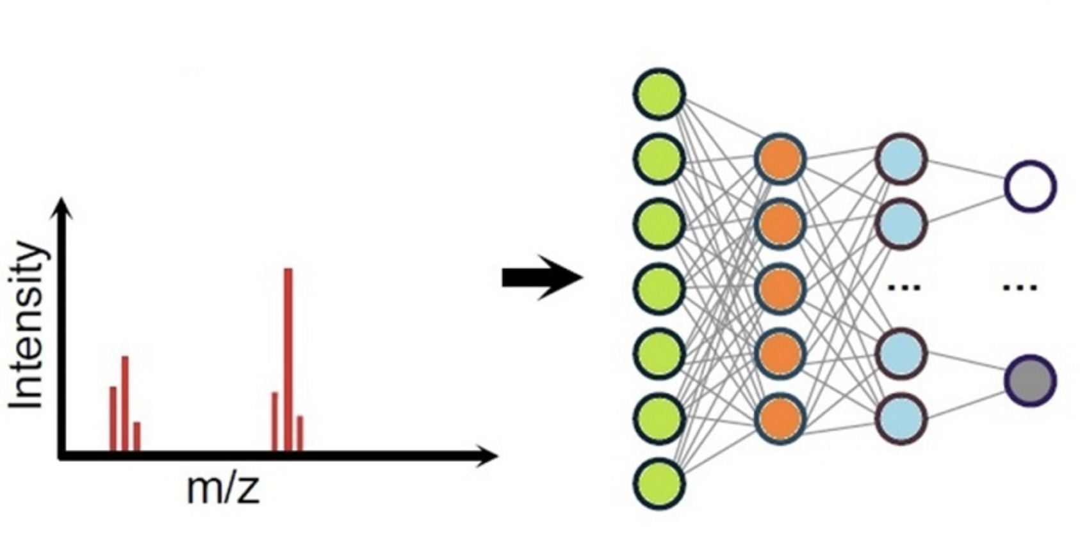
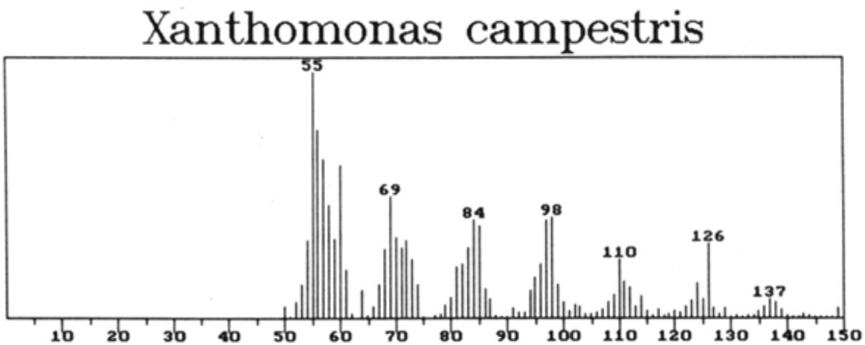
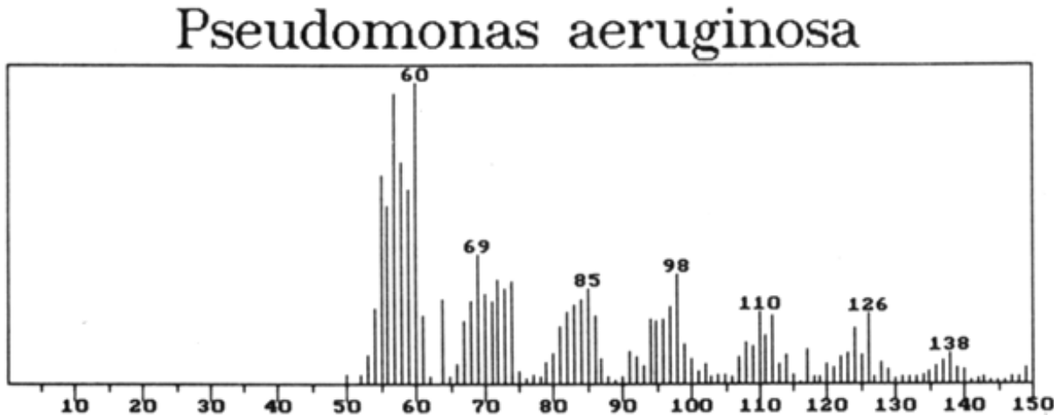
Classifying Complex Samples:
Pyrolysis MassSpec
(circa 1986)
Xanthomonas
(plant pathogens)
Pseudomonas
(ubiquitous)

Slide 19
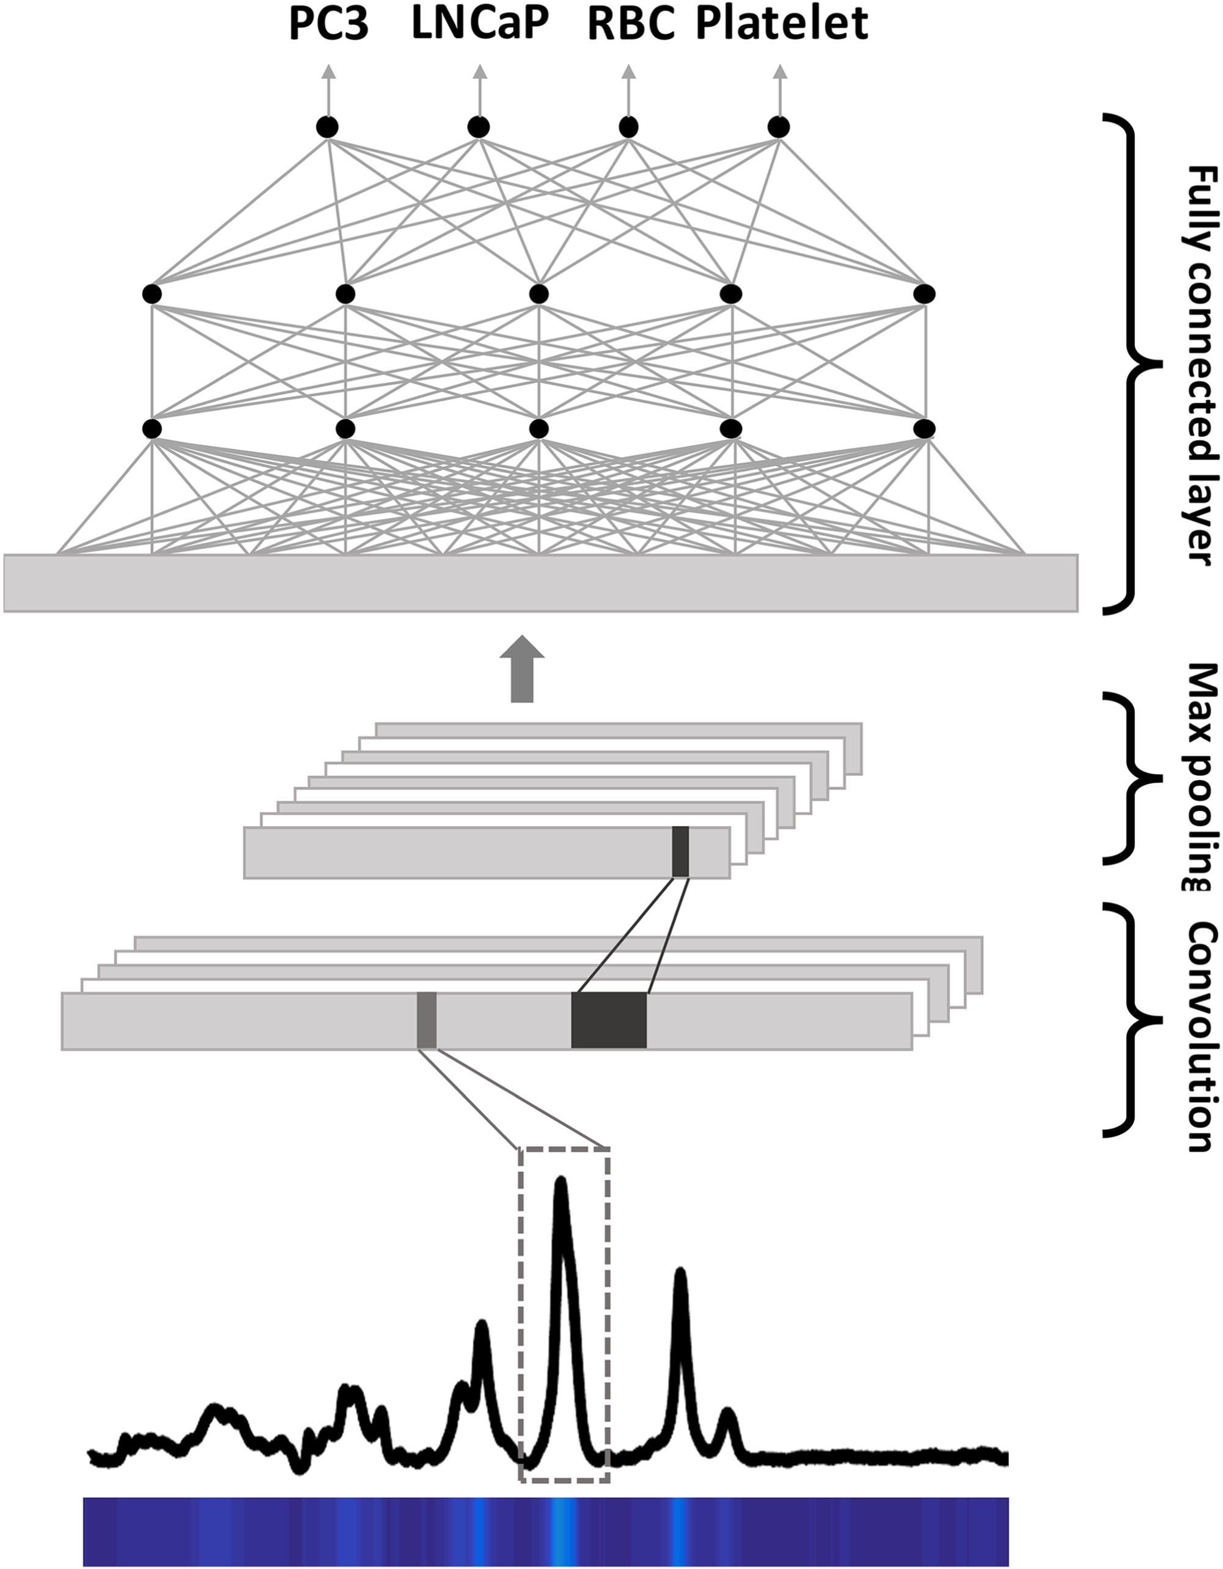
Classifying Raman Spectra of Extracellular Vesicles based on Convolutional Neural Networks for Prostate Cancer Detection
(2019)
Prostate cancer cell line [PC3]
Lymph node carcinoma of the prostate [LNCaP]
https://doi.org/10.1002/jrs.5770

Slide 20
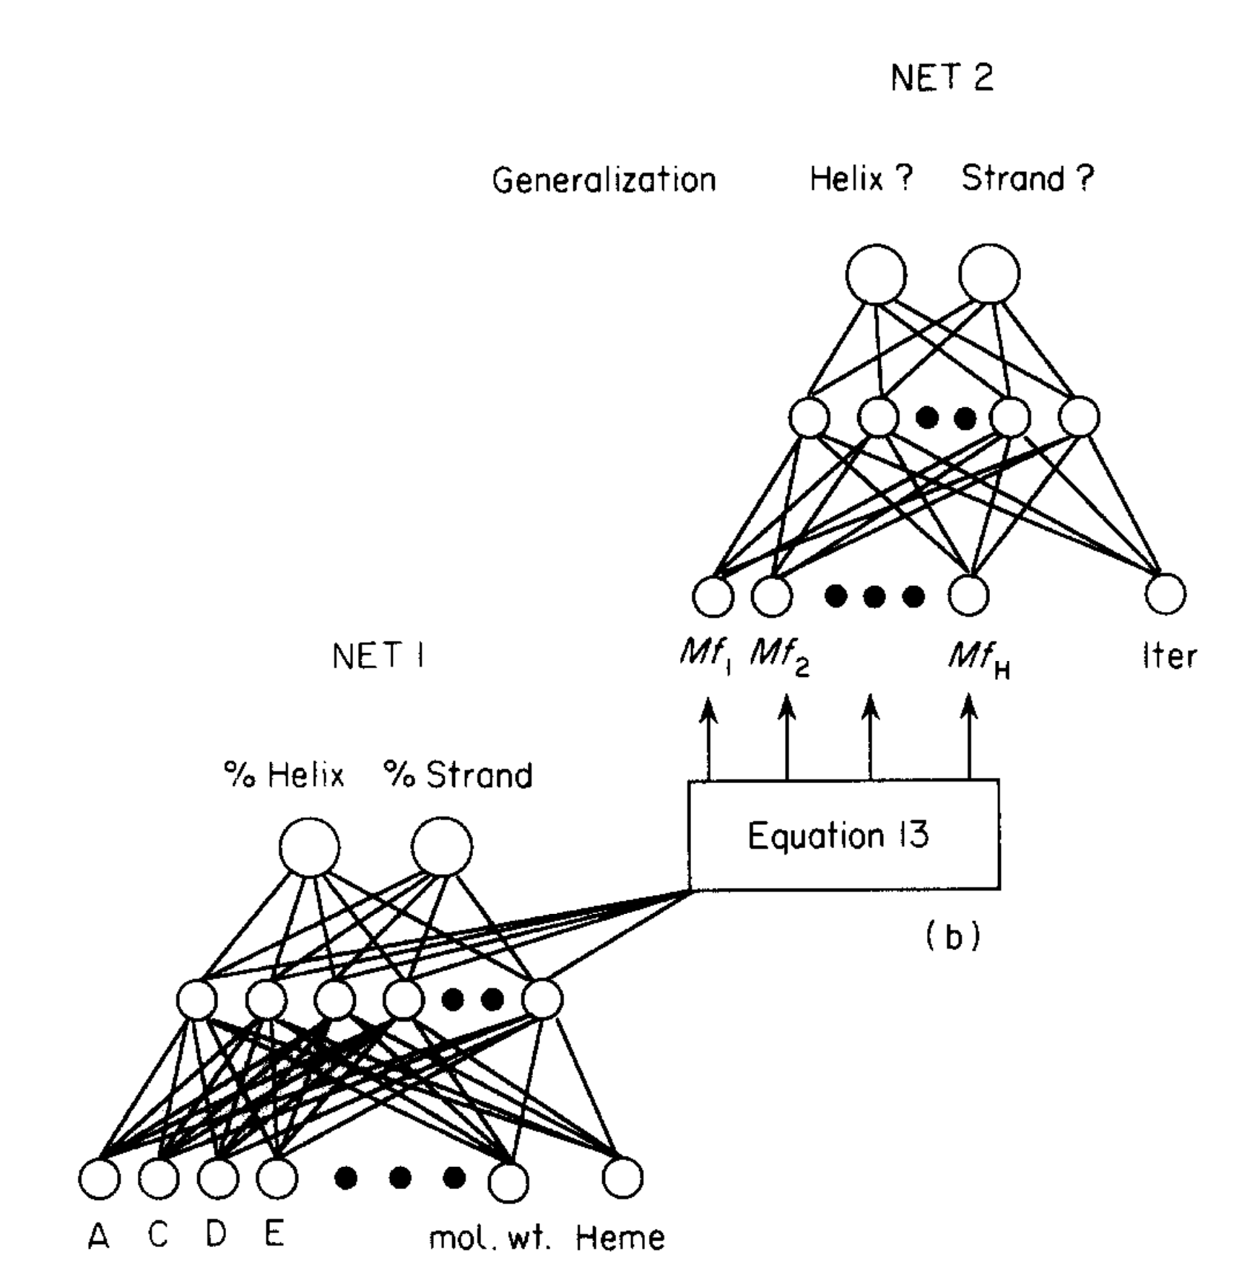
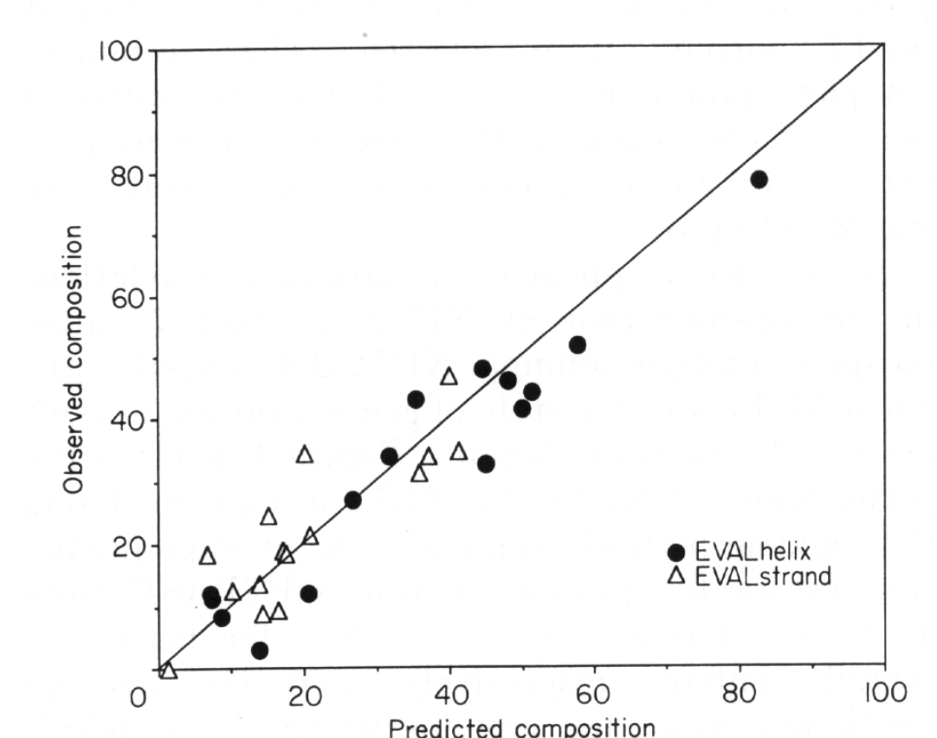
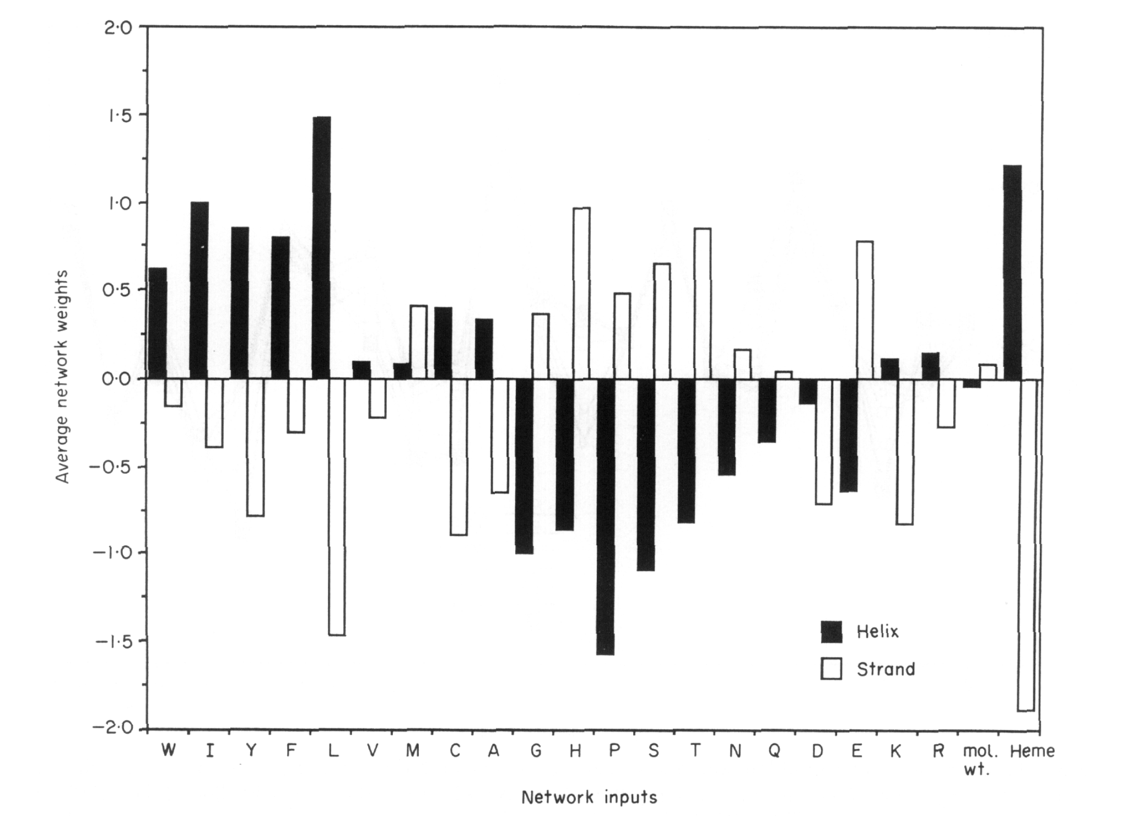
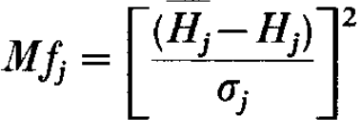
Predicting Protein Secondary Structure Content
(1992)
https://pubmed.ncbi.nlm.nih.gov/1602478/

Slide 21
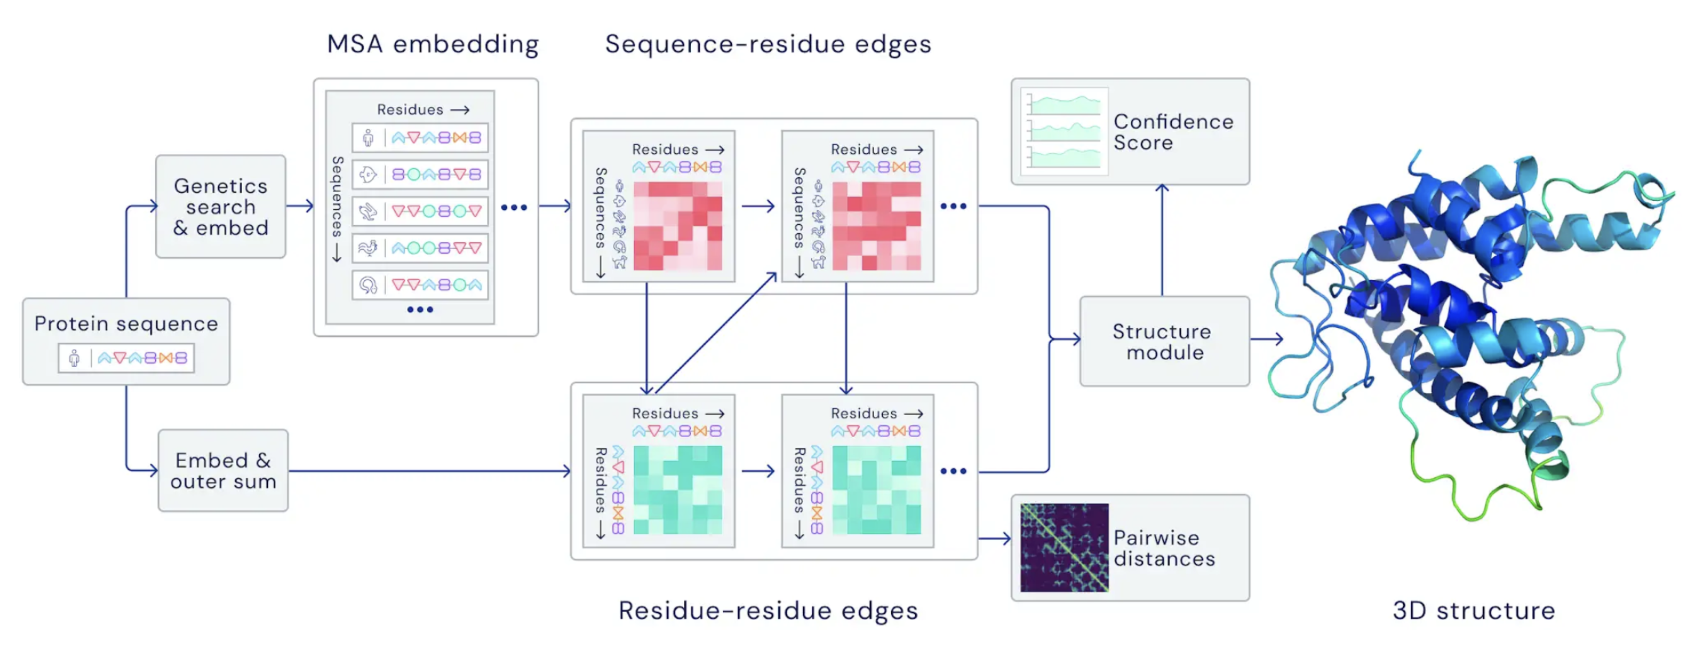
Highly accurate protein structure prediction with AlphaFold
(2021)
https://www.nature.com/articles/s41586-021-03819-2

Slide 22
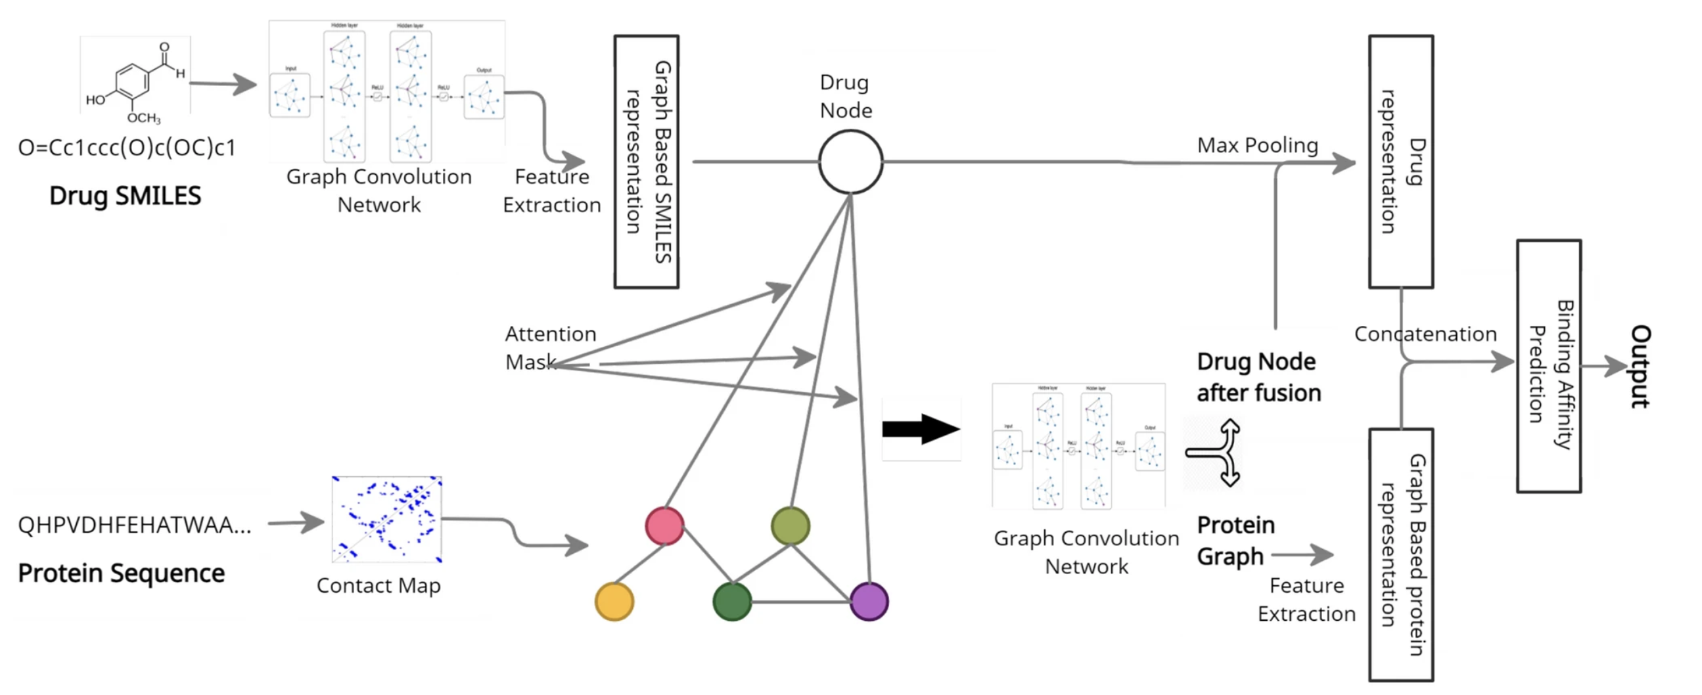
Generating novel molecule for target protein (SARS-CoV-2) using drug–target interaction based on graph neural network
(2022)
https://link.springer.com/article/10.1007/s13721-021-00351-1

Slide 23
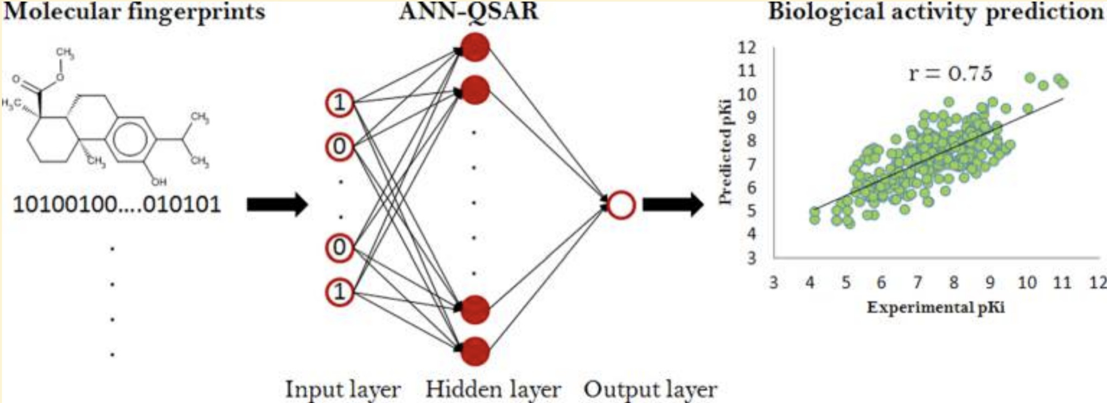
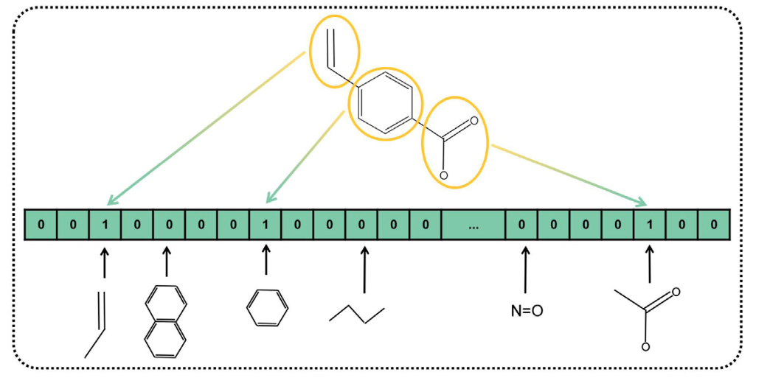
MDL Keys and QSAR
(circa 1993)

Slide 24
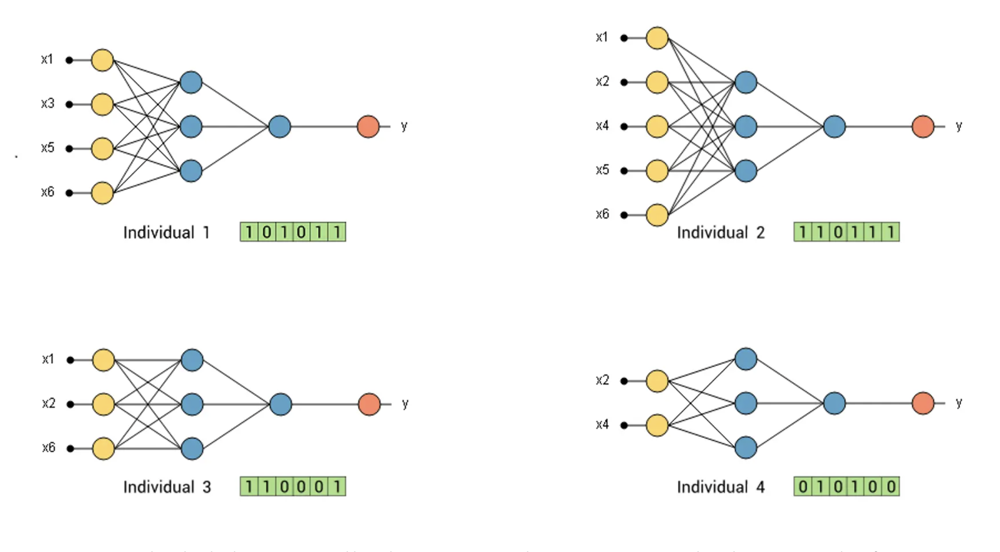
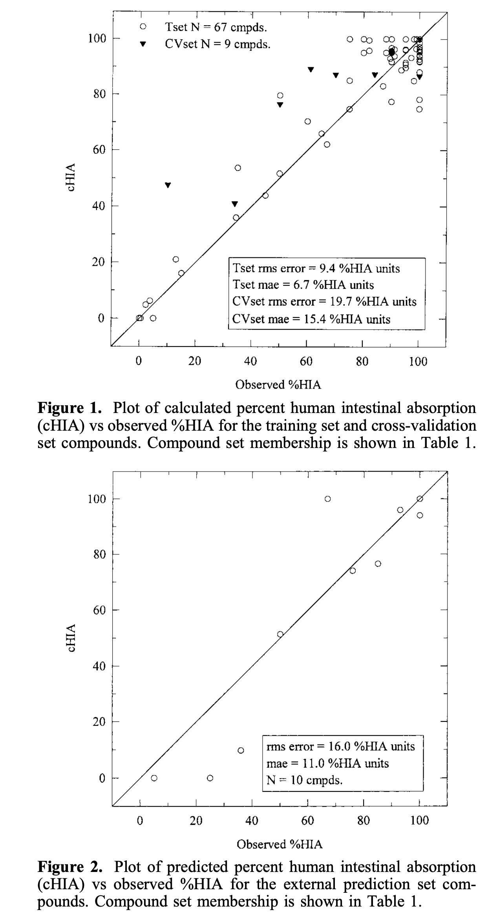
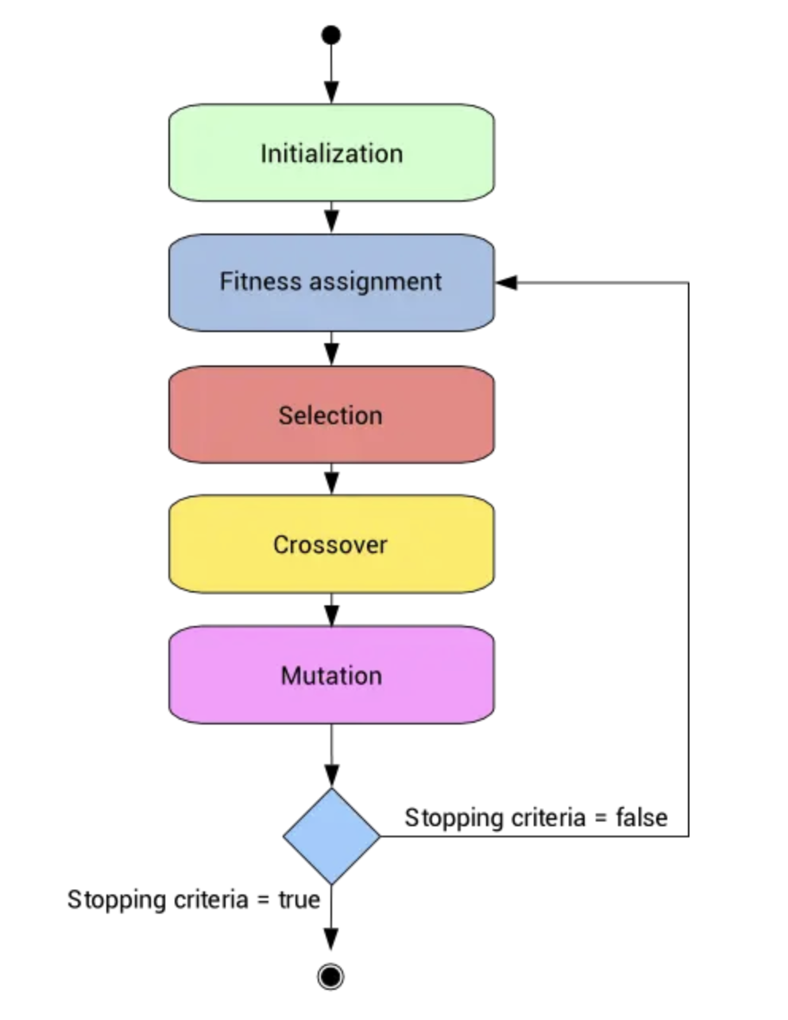
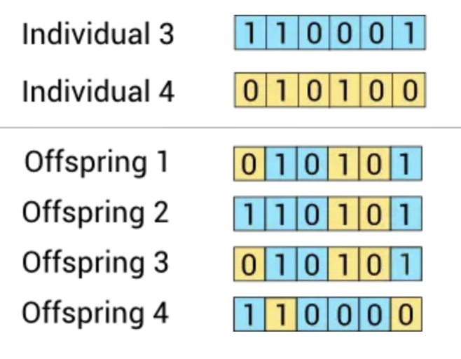
Prediction of Human Intestinal Absorption of Drug Compounds from Molecular Structure
(1998)
J. Chem. Inf. Comput. Sci. 1998, 38, 726-735

Slide 25
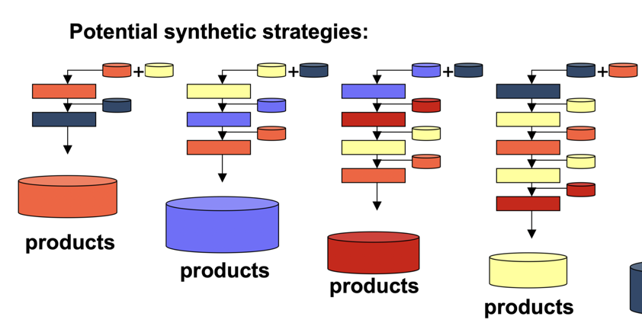
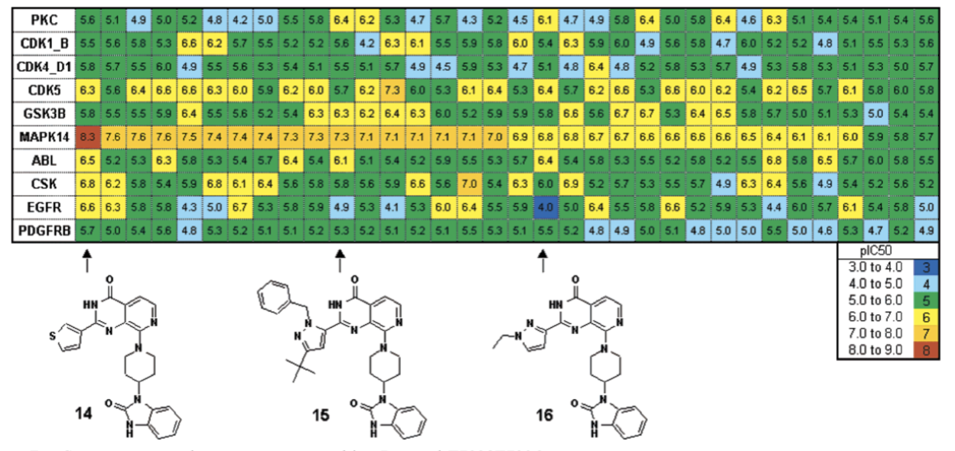
Prospective Exploration of Synthetically Feasible, Medicinally Relevant Chemical Space
(2004)
https://pubmed.ncbi.nlm.nih.gov/15807484/

Slide 26
Strain Engineering & Expression:
ML analyzes genes to identify modifications for improved yield/quality.
Predicts effects of genetic changes on protein expression in Pichia.
Optimal Expression Conditions:
Neural networks model & predict best growth conditions (temp, pH, nutrients).
Analyze past fermentations to optimize Pichia for maximum yield.
Scalability:
Machine learning predicts how scaling affects fermentation outcomes.
Simulates large-scale Pichia processes based on small-scale data.
Methanol Utilization Control:
Neural networks optimize methanol feeding in Pichia pastoris fermentations.
Predict optimal feeding rate for maximum protein expression without toxicity.
Post-Translational Modifications:
AI analyzes patterns to ensure consistent, high-quality Pichia products.
Crucial for therapeutic proteins where modifications affect efficacy/safety.
Product Recovery and Purification:
Machine learning optimizes downstream processing for Pichia-produced proteins.
Predicts most efficient purification methods and conditions.
Contamination Control:
Neural networks monitor Pichia fermentations for real-time contamination detection.
Design processes that minimize contamination risk using predictive models.
Regulatory Compliance:
AI monitors and documents Pichia production parameters for regulatory compliance.
Ensures processes adhere to relevant guidelines.
Cost-Effectiveness:
Machine learning models optimize the overall Pichia production process for cost.
Balances factors like raw materials, energy use, and yield.
Advances in Bioreactor Design and Process Monitoring:
Neural networks design advanced bioreactors and process monitoring systems for Pichia.
Analyze complex data sets to improve control strategies and reactor designs.

Slide 27
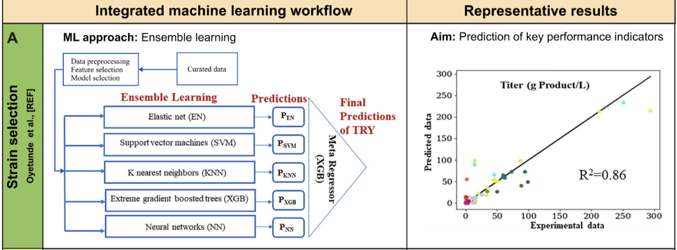
Strain Selection
(2019)
Oyetunde, T. et al. (2019) Machine learning framework for assessment of microbial factory performance. PLoS One 14, e0210558. 10.1371/journal.pone.0210558
https://pubmed.ncbi.nlm.nih.gov/36456404/

Slide 28
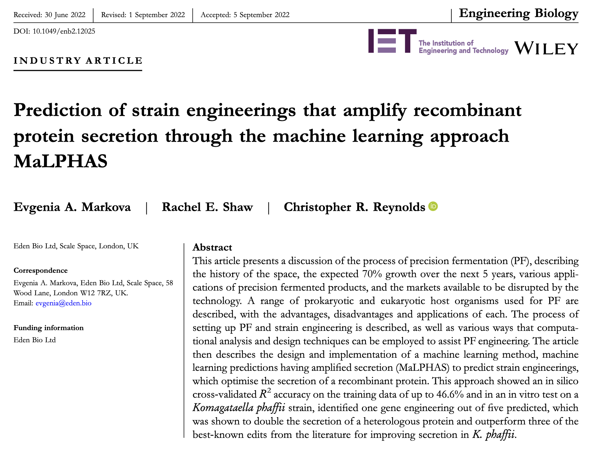
Strain Engineering
(2022)
https://ietresearch.onlinelibrary.wiley.com/doi/10.1049/enb2.12025

Slide 29
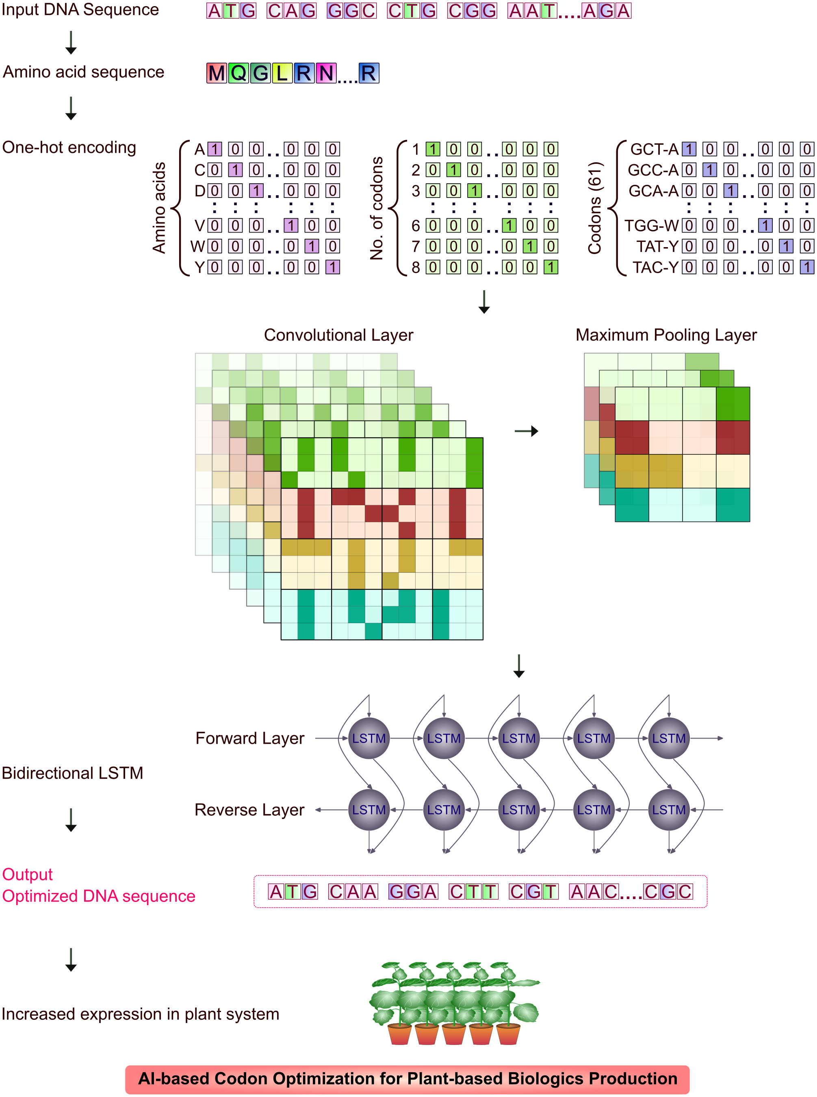
Codon optimization for plant expression system
(2023)
https://www.frontiersin.org/journals/plant-science/articles/10.3389/fpls.2023.1252166/full

Slide 30
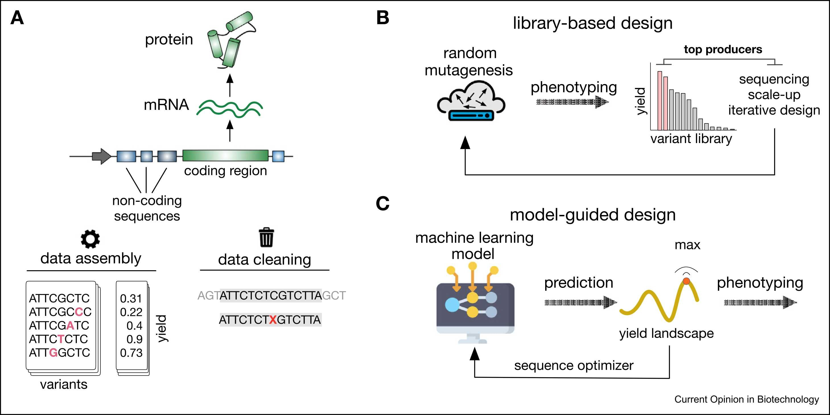
Deep learning for optimization of protein expression
(2023)
https://pubmed.ncbi.nlm.nih.gov/37087839/

Slide 31
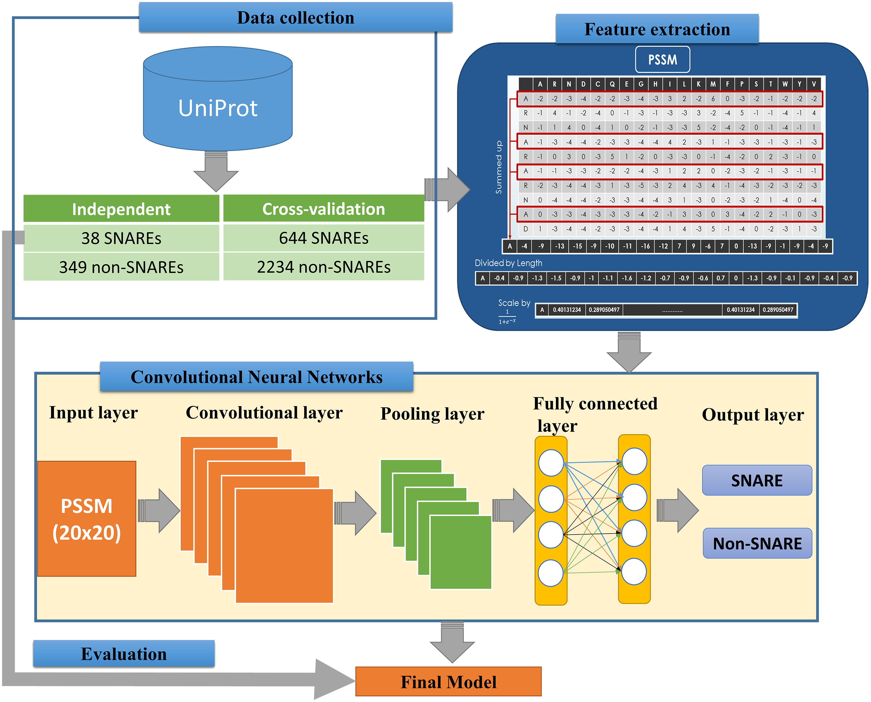
SNARE-CNN: a 2D Convolutional Neural Network Architecture to Identify SNARE Proteins from High-Throughput Sequencing Data
(2019)
https://peerj.com/articles/cs-177/

Slide 32
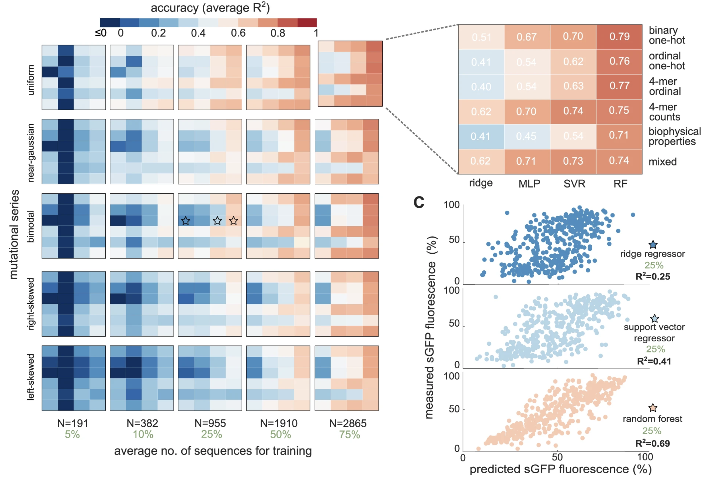
Accuracy and Data Efficiency in Deep Learning Models of Protein Expression
(2022)
https://www.nature.com/articles/s41467-022-34902-5

Slide 33
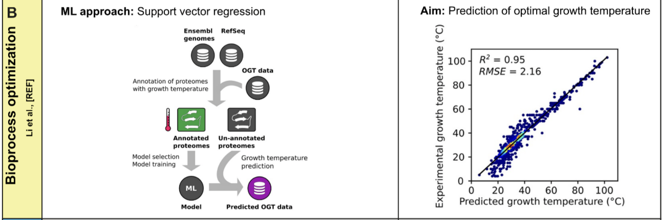
Bioprocess Optimization
(2019)
Li, G. et al. (2019) Machine Learning Applied to Predicting Microorganism Growth Temperatures and Enzyme Catalytic Optima. ACS Synth Biol 8, 1411-1420. 10.1021/acssynbio.9b00099
https://pubmed.ncbi.nlm.nih.gov/36456404/

Slide 34
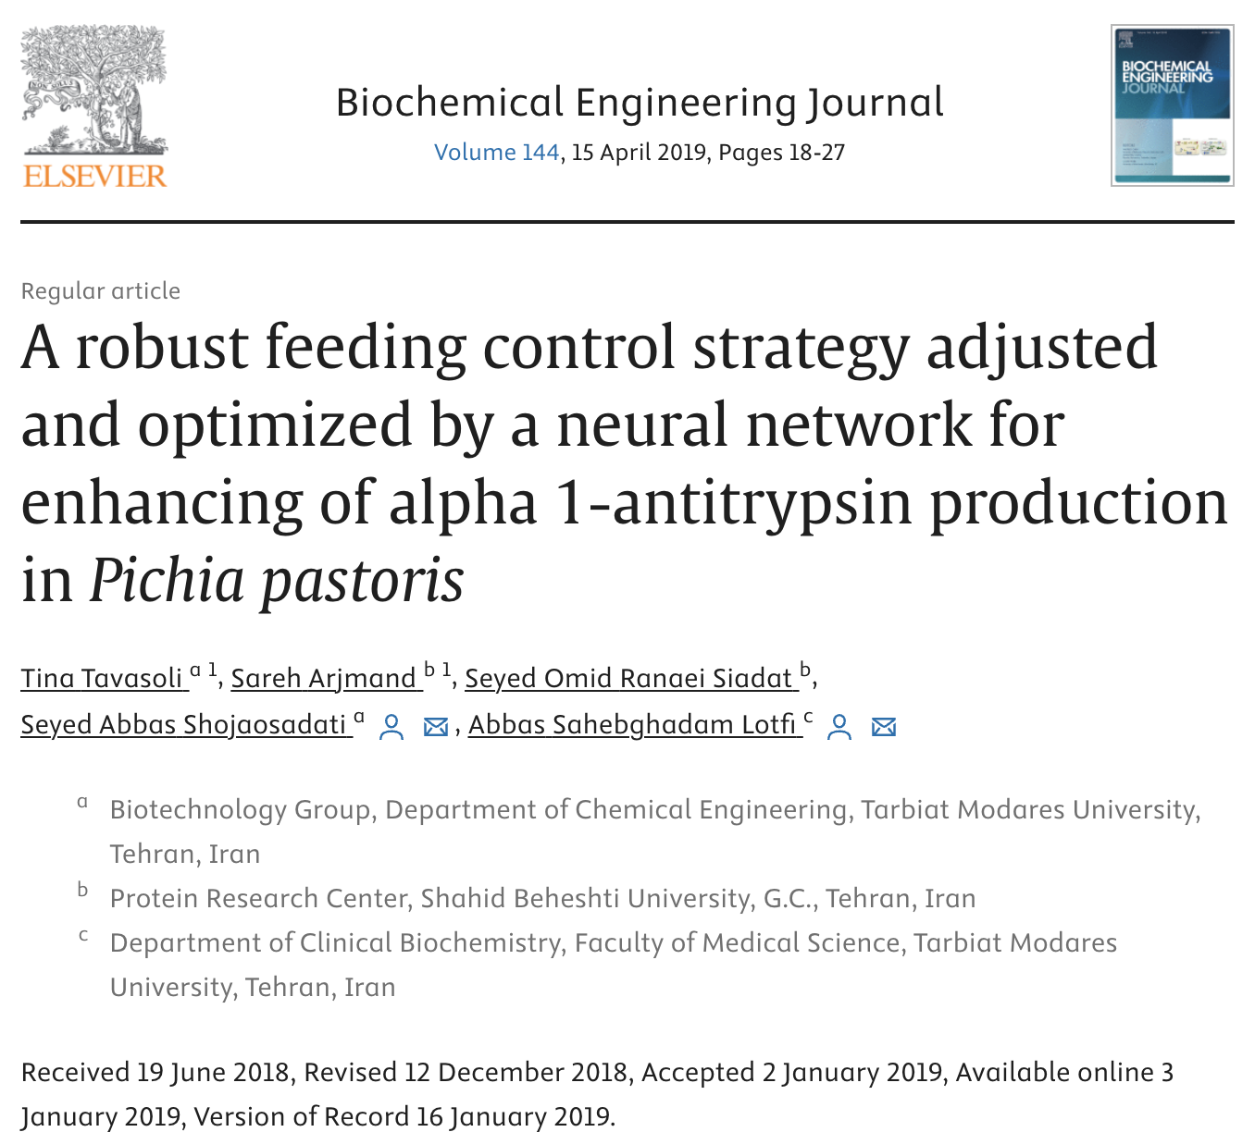
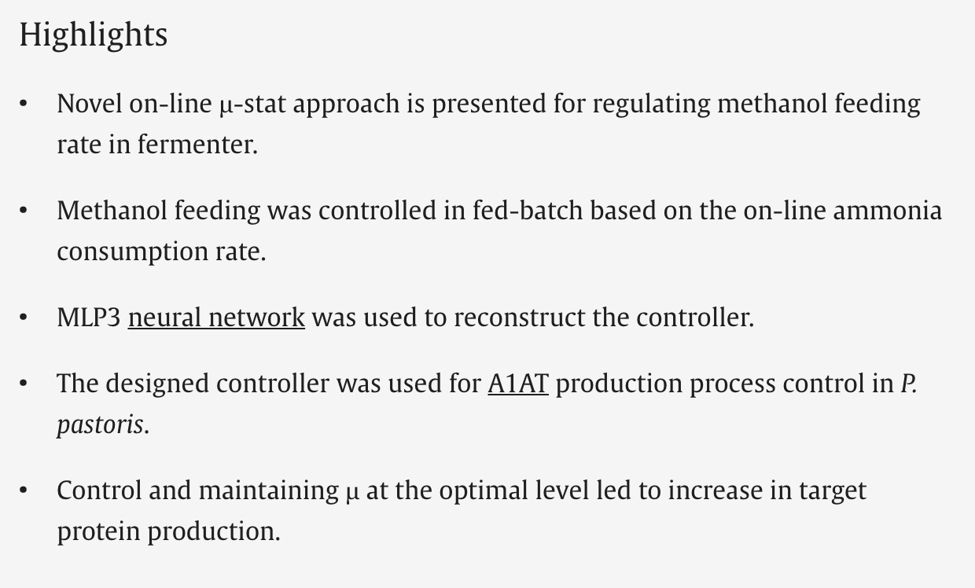
Process optimization
(2019)
https://www.sciencedirect.com/science/article/abs/pii/S1369703X19300051

Slide 35
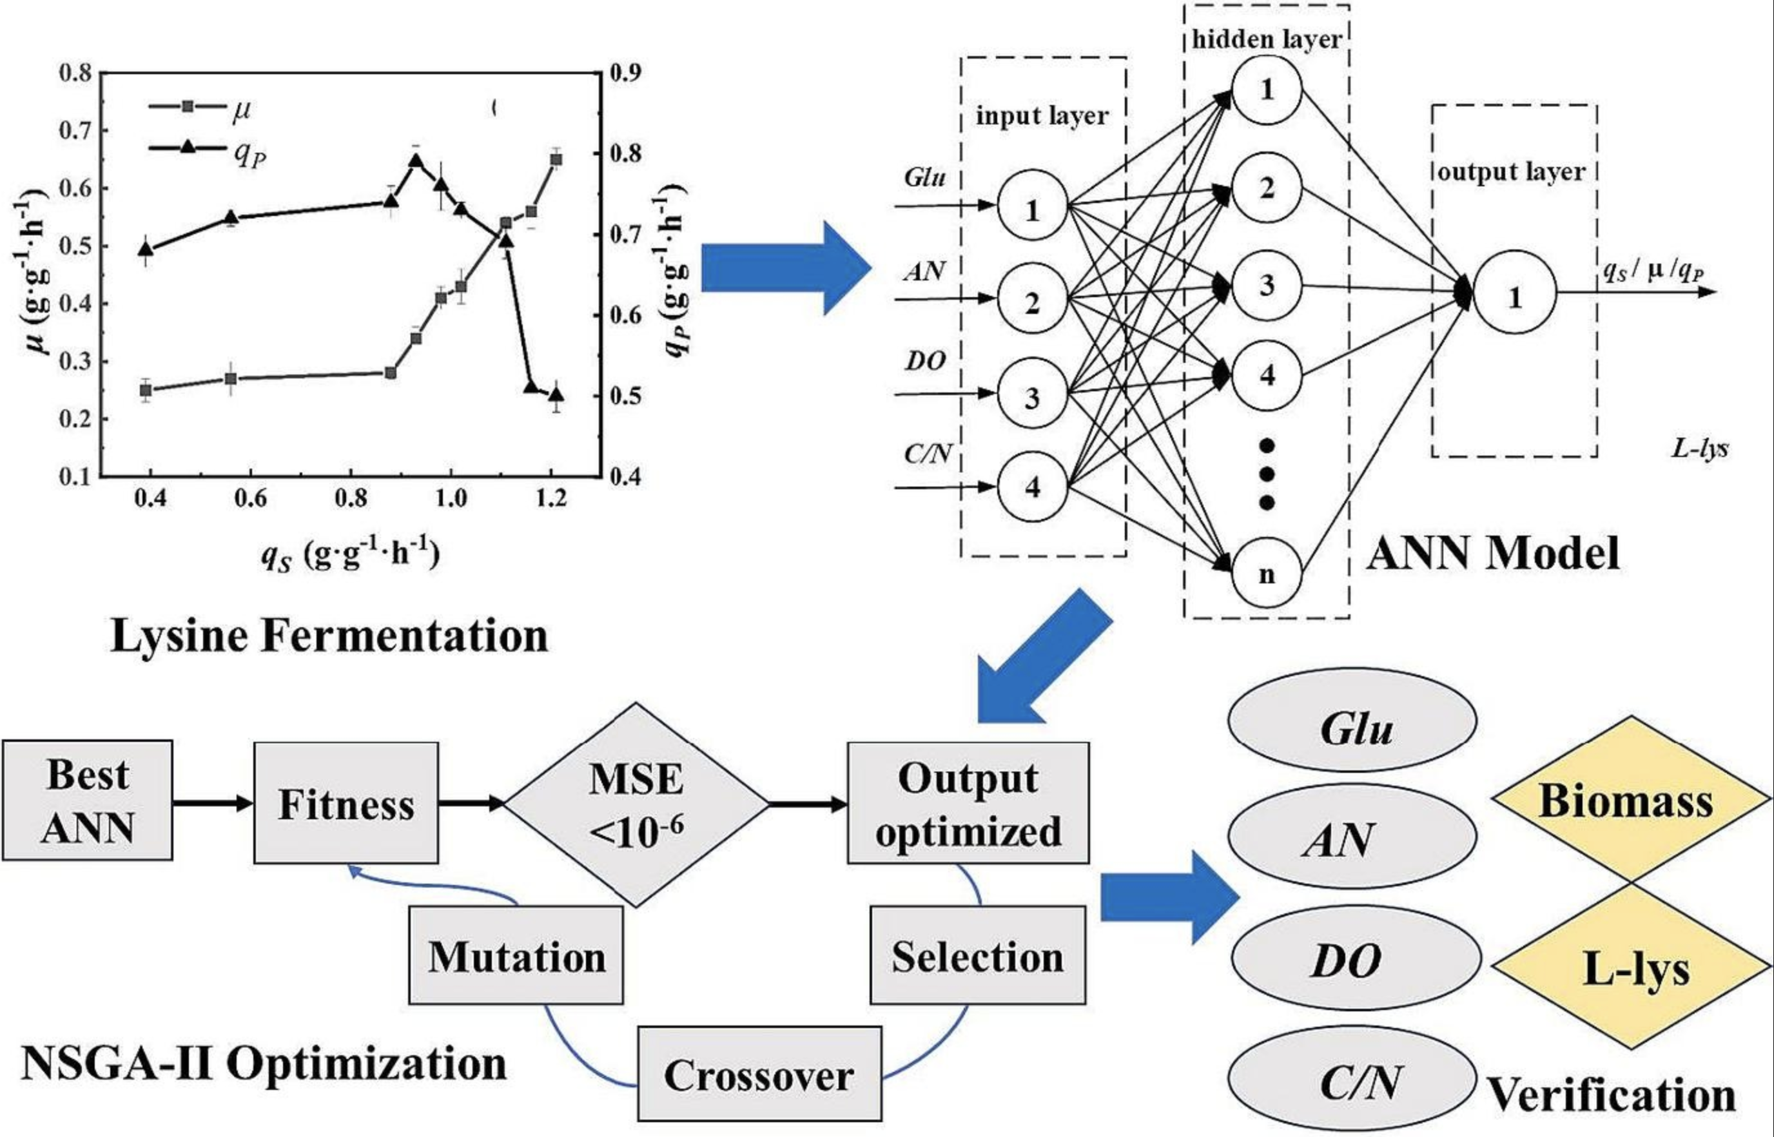
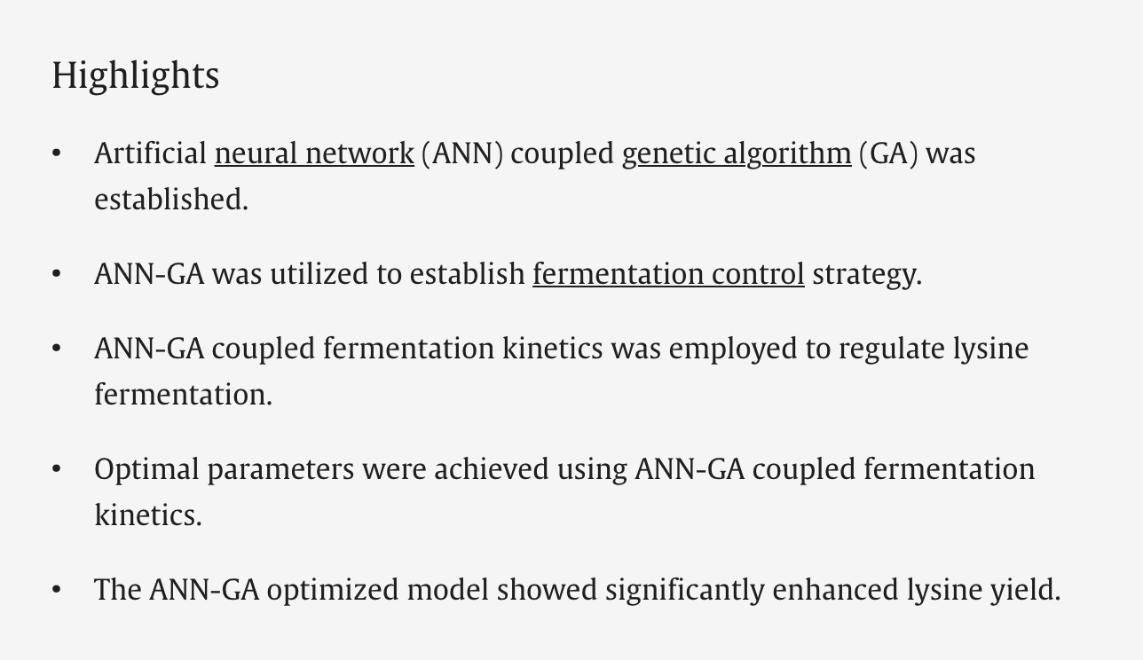
Artificial Neural Network and Genetic Algorithm Coupled Fermentation Kinetics to Regulate L-Lysine Fermentation
(2024)
https://doi.org/10.1016/j.biortech.2023.130151

Slide 36
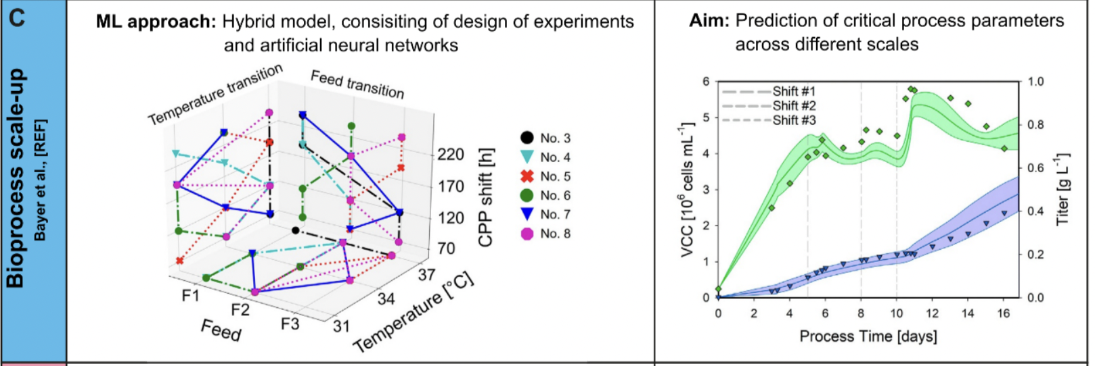
Bioprocess Scale-Up
(2021)
Bayer, B. et al. (2021) Model Transferability and Reduced Experimental Burden in Cell Culture Process Development Facilitated by Hybrid Modeling and Intensified Design of Experiments. Front Bioeng Biotechnol 9, 740215. 10.3389/fbioe.2021.740215
https://pubmed.ncbi.nlm.nih.gov/36456404/

Slide 37
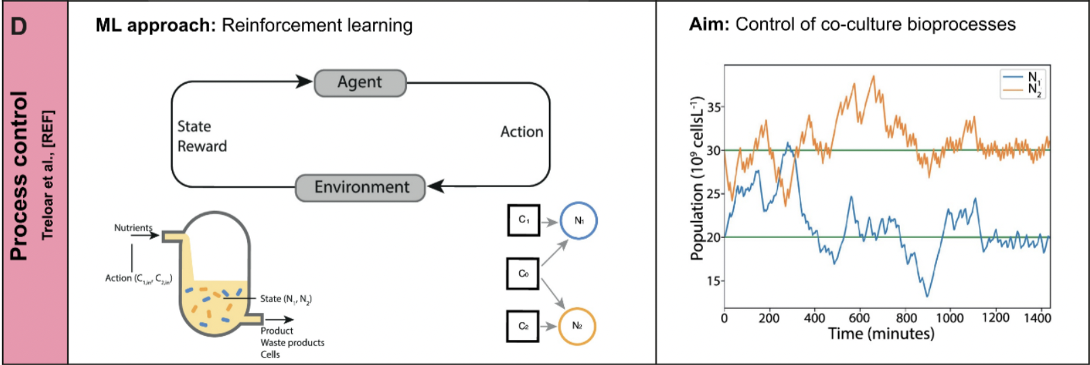
Process Control
(2020)
Treloar, N.J. et al. (2020) Deep reinforcement learning for the control of microbial co-cultures in bioreactors. PLoS Comput Biol 16, e1007783. 10.1371/journal.pcbi.1007783
https://pubmed.ncbi.nlm.nih.gov/36456404/

Slide 38
MeOH Feeding Control Strategy Adjusted/Optimized by a Neural Network
alpha 1-antitrypsin production in Pichia pastoris
(2019)
https://www.sciencedirect.com/science/article/abs/pii/S1369703X19300051

Slide 39
Transformer Architecture Simplified
https://medium.com/@tech-gumptions/transformer-architecture-simplified-3fb501d461c8

Slide 40
Here’s a breakdown of the diagram:
Encoder-decoder architecture: The model is divided into two parts: an encoder and a decoder. The encoder’s role is to receive the input sequence and transform it into a contextual representation. The decoder’s role is to generate the output sequence based on the encoded representation.
Layers: Both the encoder and decoder consist of multiple layers stacked on top of each other. Each layer refines the previous layer’s output.
Self-attention mechanism: This is a core component of the Transformer model. It allows the model to attend to relevant parts of the input sequence when processing a word. In the image, this is depicted by the “Multi-head Self Attention” block.
Layer normalization: This is another essential building block that helps stabilize the training process of the model.
Input and output embeddings: These are dense vector representations of words in the input and output sequences. The embedding layer maps words from the vocabulary space into a continuous vector space.
Overall, the Transformer model takes an input sequence, encodes it, and then decodes it to generate an output sequence. The self-attention mechanism allows the model to focus on important parts of the input sequence when generating the output.
https://medium.com/machine-intelligence-and-deep-learning-lab/transformer-the-self-attention-mechanism-d7d853c2c621

Slide 41
Explaining Convolutional Neural Networks
https://www.simplilearn.com/tutorials/deep-learning-tutorial/convolutional-neural-network
https://poloclub.github.io/cnn-explainer/

Slide 42
Convolutional Neural Network:
Image Classification
https://peerj.com/articles/cs-773/

Slide 43
Convolutional Neural Network:
Structural Health Monitoring
https://pubmed.ncbi.nlm.nih.gov/31726762/
https://pubmed.ncbi.nlm.nih.gov/31726762/

